Slide 1
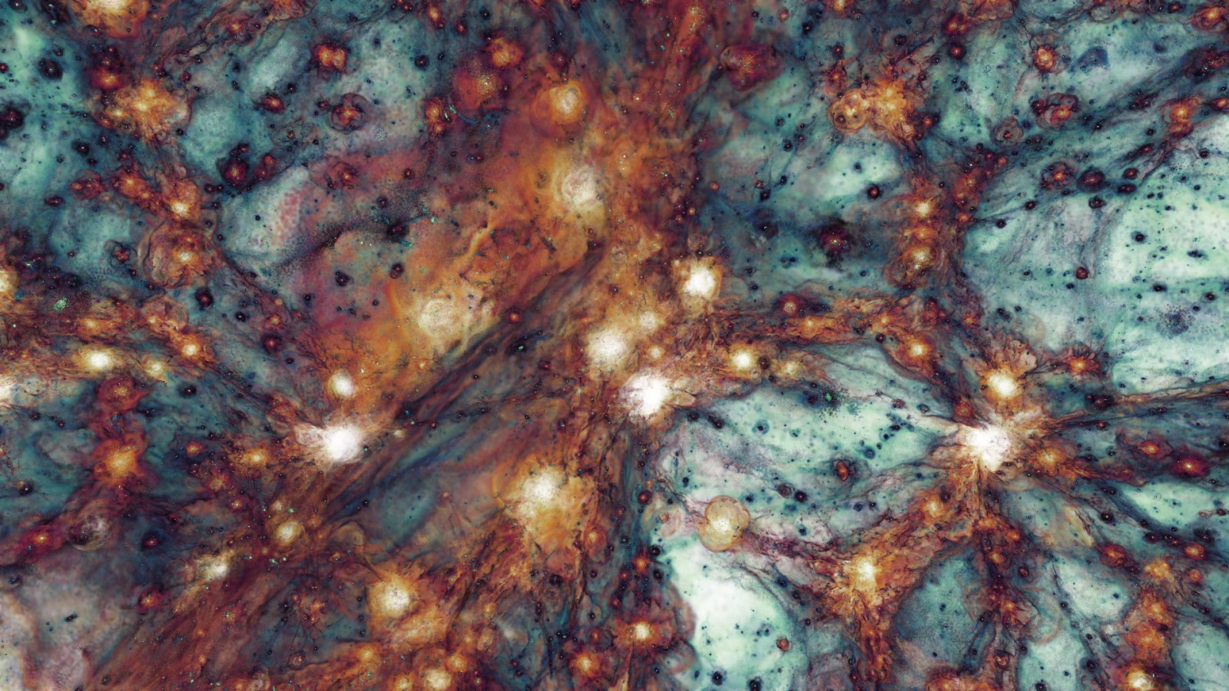


Memory Intensive simulations in cosmology and galaxy formation
Adrian Jenkins
Institute for Computational Cosmology
Durham
DiRAC day 12th December 2024

Slide 2
Overview
Memory Intensive calculations
The DiRAC-3 Memory Intensive System
The SWIFT hydrodynamic code
Two examples using SWIFT of MI simulations:
Flamingo project - Large-scale structure
Colibre project - Galaxy formation
Summary

Slide 3
Memory Intensive simulations (a short history)
1998 Virgo N-body simulations - T3D Edinburgh
1999 GIF N-body simulations - RZG, Garching, Germany
2002 Hubble volume simulations. - RZG, Garching, Germany
2005 Millennium N-body simulation - RZG Garching, Germany
2008 Millennium II N-body simulation - RZG Garching, Germany
2011 MXXL Nbody simulation - Julich, Germany
2015 Eagle hydrodynamical simulation - DiRAC-2
2023 Flamingo hydrodynamic simulations - DiRAC-3 MI
2024+ Colibre simulations - on-going - DiRAC-3 MI
2024 Flamingo 10K N-body simulation completed DiRAC-3 MI
2024 Millennium TNG 10240³ N-body simulation DiRAC-3 MI

Slide 4
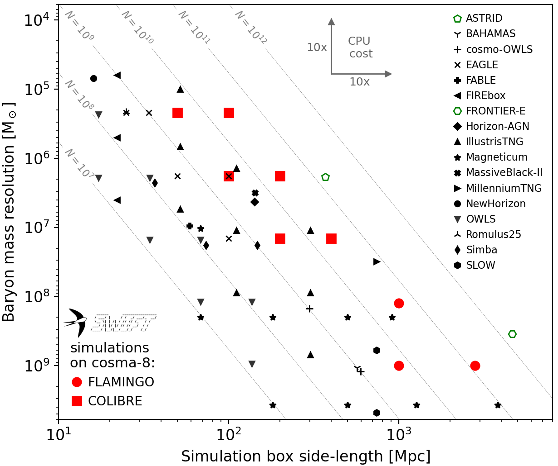
Credit: Matthieu Schaller

Slide 5
Overview
Memory Intensive calculations
The DiRAC-3 Memory Intensive System
The SWIFT hydrodynamic code
Two examples using SWIFT of MI simulations:
Flamingo project - Large-scale structure
Colibre project - Galaxy formation
Summary

Slide 6

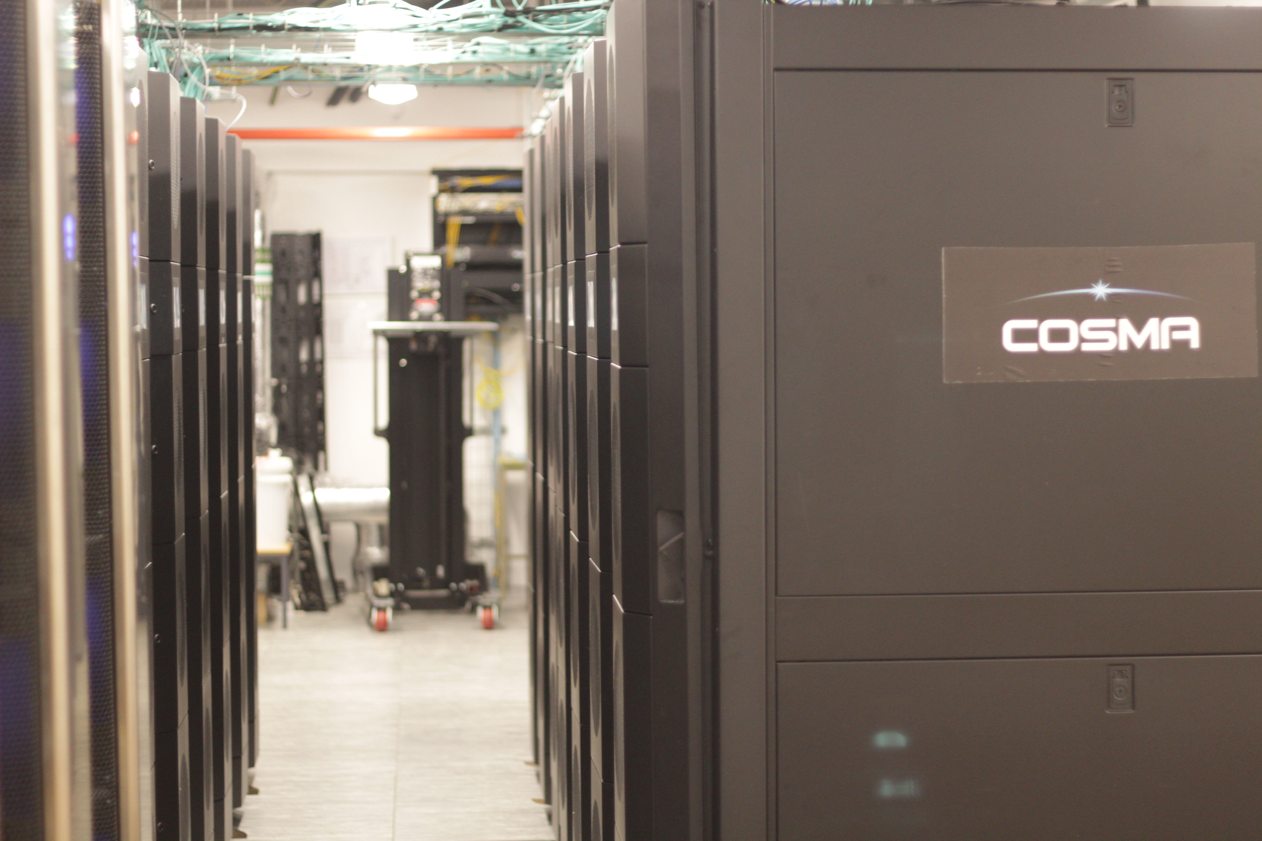
Memory Intensive system at Durham (Cosma-8)
dirac.ac.uk
Prototype in service from October 2020. - 32 nodes with dual Rome 7H12
Phase 1 (2021) DiRAC-3 grew to 360 nodes with additional Rome 7H12 nodes.
Phase 2 (2023) DiRAC-3 expanded to 528 with addition of 168 Milan 7763 nodes
Mellanox HDR, 200 Gbit/s - non-blocking fat tree topology
All nodes have 1 TB of RAM
As part of phase 1 the snap8 filesystem - 1.2PB
Total storage today about 15 PB
Tape storage 26 PB
x10 more RAM than DiRAC-2 (Cosma-5)

Slide 7
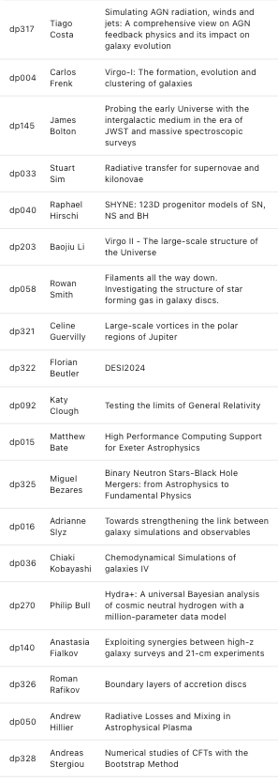
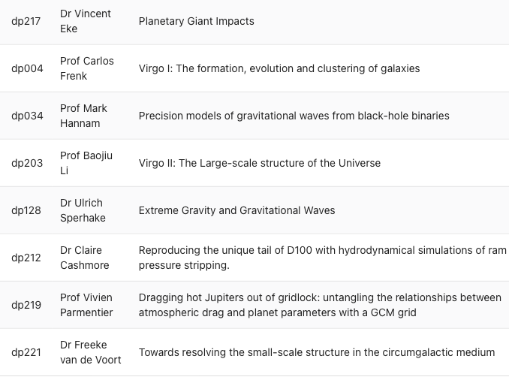
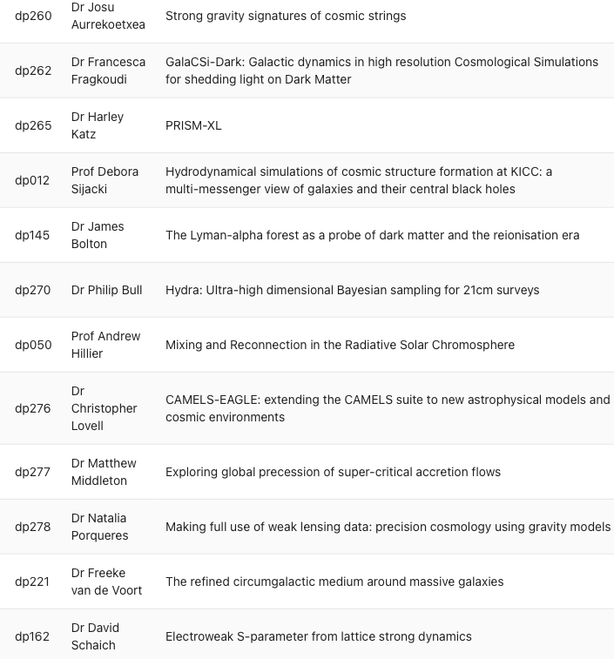
Memory Intensive RAC projects
14th call
15th call
16th call

Slide 8
Overview
Memory Intensive calculations
The DiRAC-3 Memory Intensive System
The SWIFT hydrodynamic code
Two examples using SWIFT of MI simulations:
Flamingo project - Large-scale structure
Colibre project - Galaxy formation
Summary

Slide 9

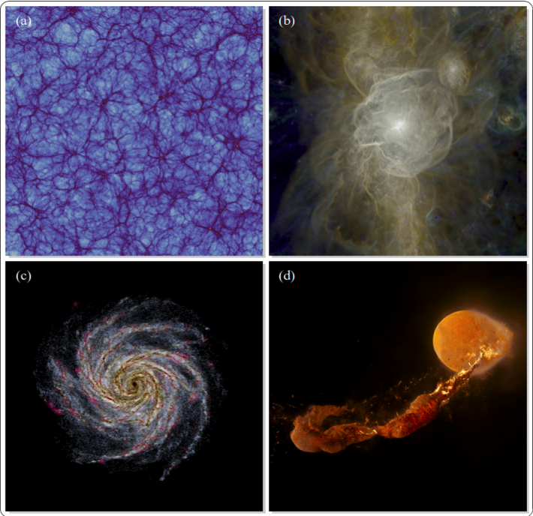
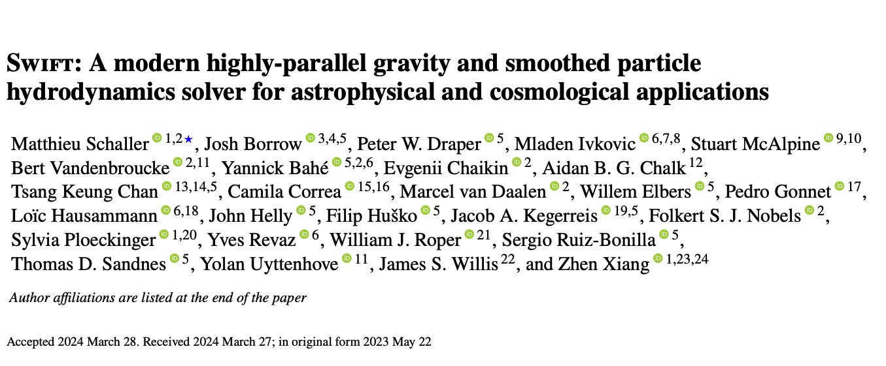
SPH With Inter-dependant Fine-gained Tasking
2024 - MNRAS, 530, 2378

Slide 10
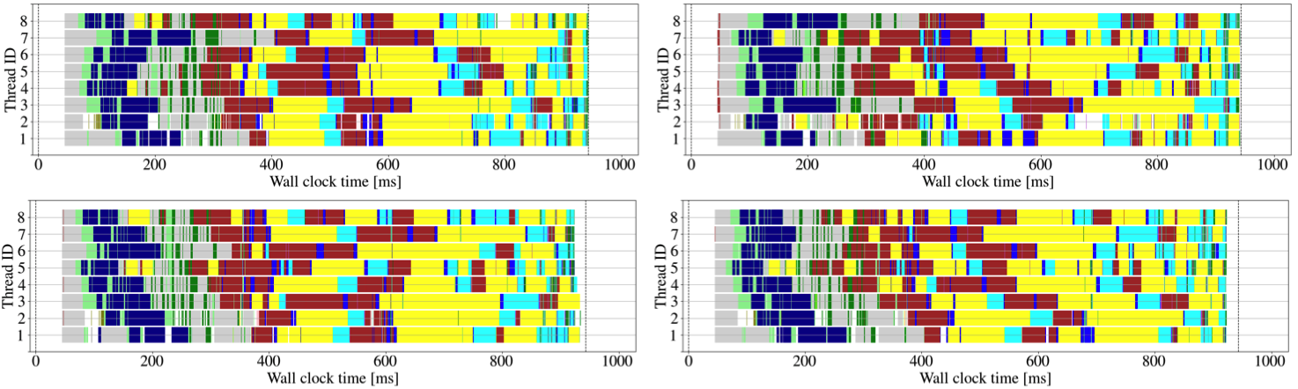
SWIFT is very good at load balancing
Schaller et al 2024

Slide 11
Overview
Memory Intensive calculations
The DiRAC-3 Memory Intensive System
The SWIFT hydrodynamic code
Two examples using SWIFT of MI simulations:
Flamingo project - Large-scale structure
Colibre project - Galaxy formation
Summary

Slide 12
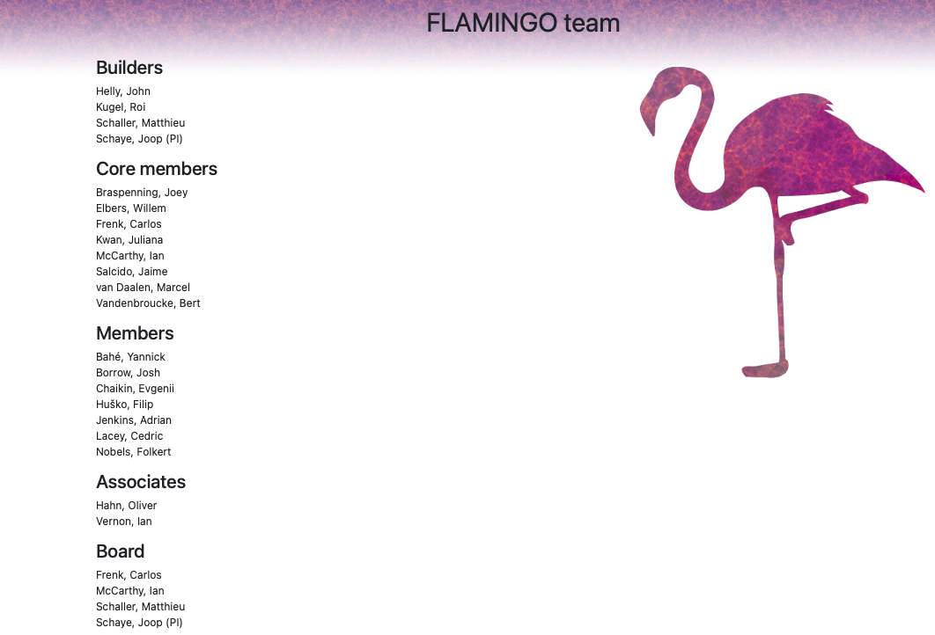

Slide 13

Flamingo simulations
To provide accurate theoretical predictions of the growth of large-scale structure
3 numerical resolutions m8/m9/m10
Subgrid model tuned to match stellar mass function in the present day universe and local cluster mass gas fractions
1 Flagship 2.8Gpc run with 2 x 5040³ gas and dark matter particles + 2800³ neutrinos
Lightcone data and Healpix maps
Suite of 1Gpc hydrodynamic simulations varying cosmology and calibration data
Dark matter only counterpart simulations plus Flamingo 10K (11.2 Gpc simulation)
Accurate initial conditions - 3LTP dark matter, baryons, neutrinos (Elbers et al 2022)
Efficient modelling of neutrinos using $δ$f method (Elbers et al 2021)

Slide 14
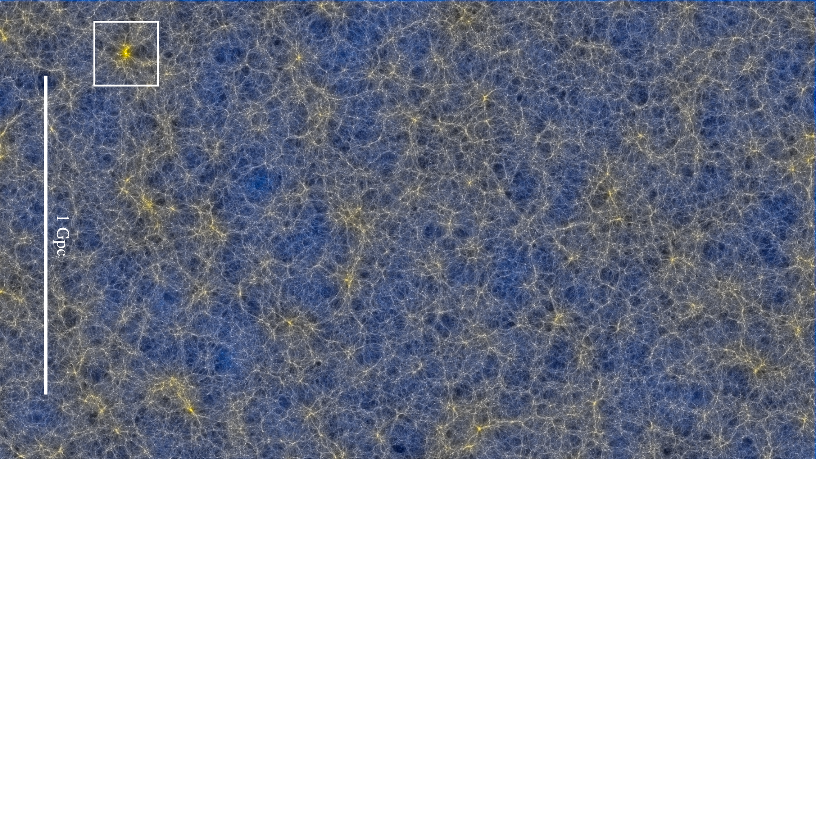
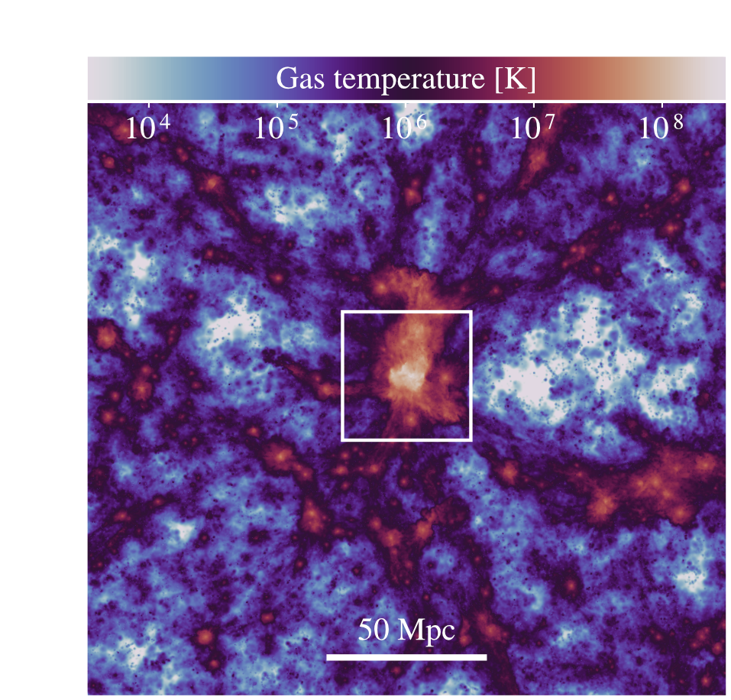
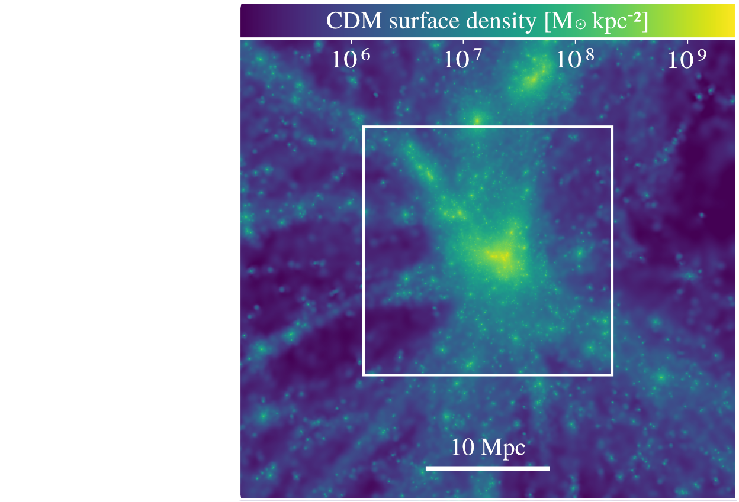
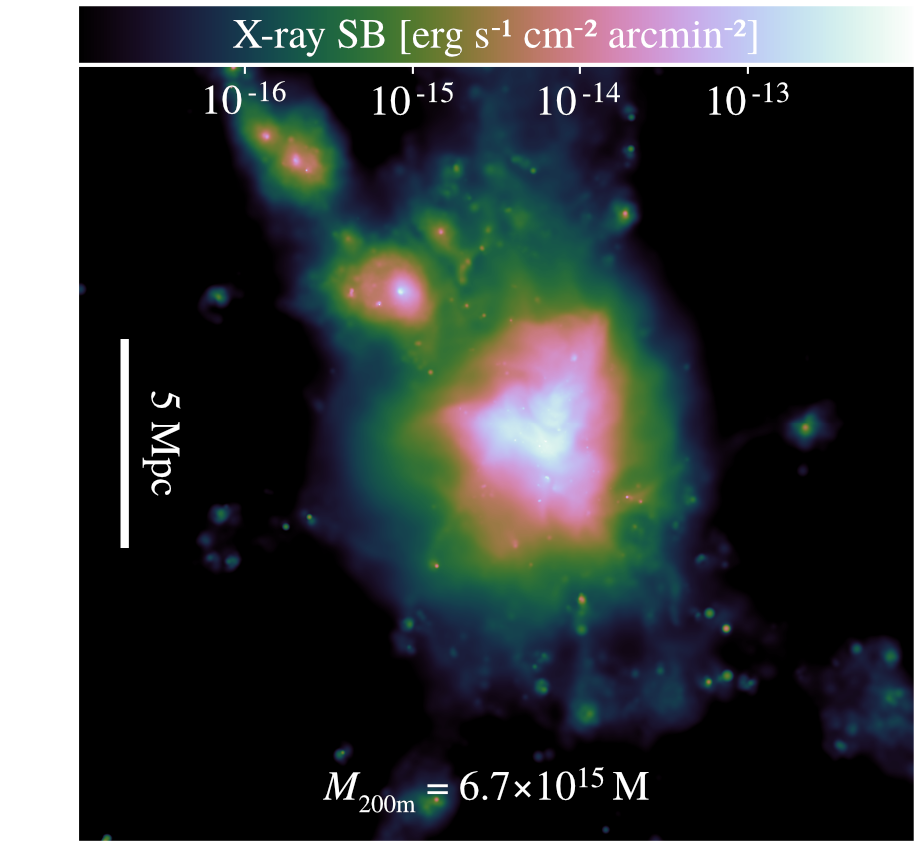

Slide 15
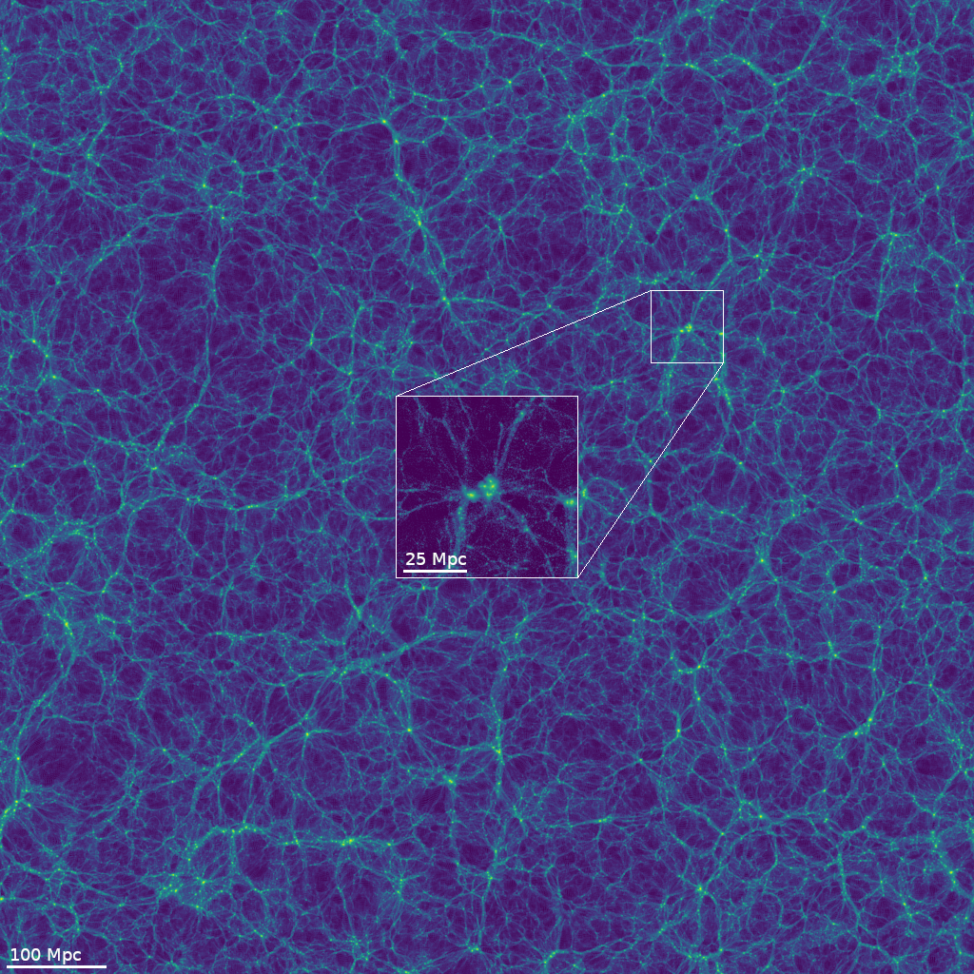
CDM
Credit: Willem Elbers

Slide 16
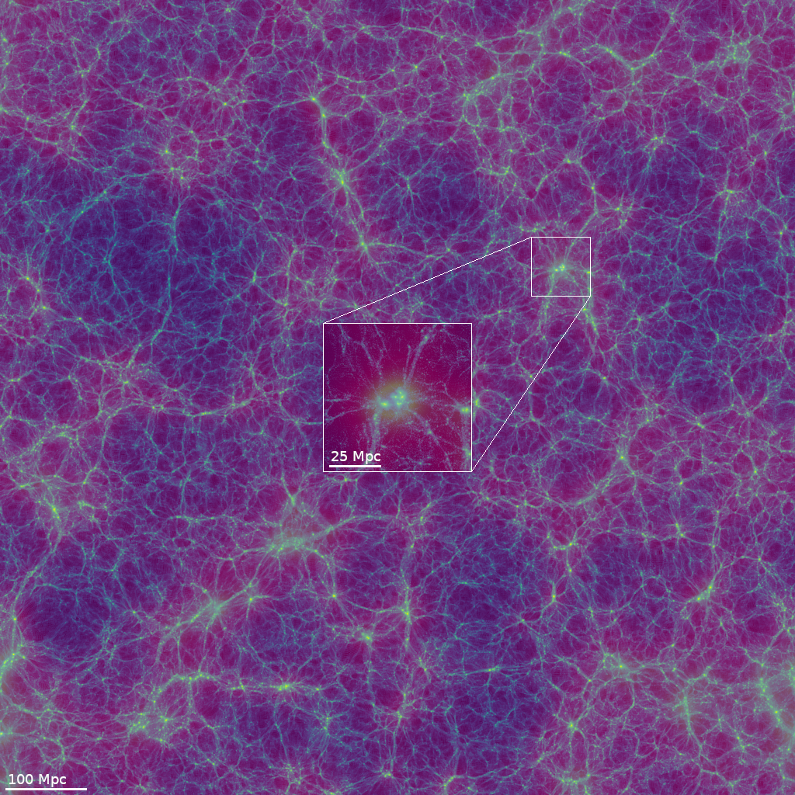
0.06eV

Slide 17
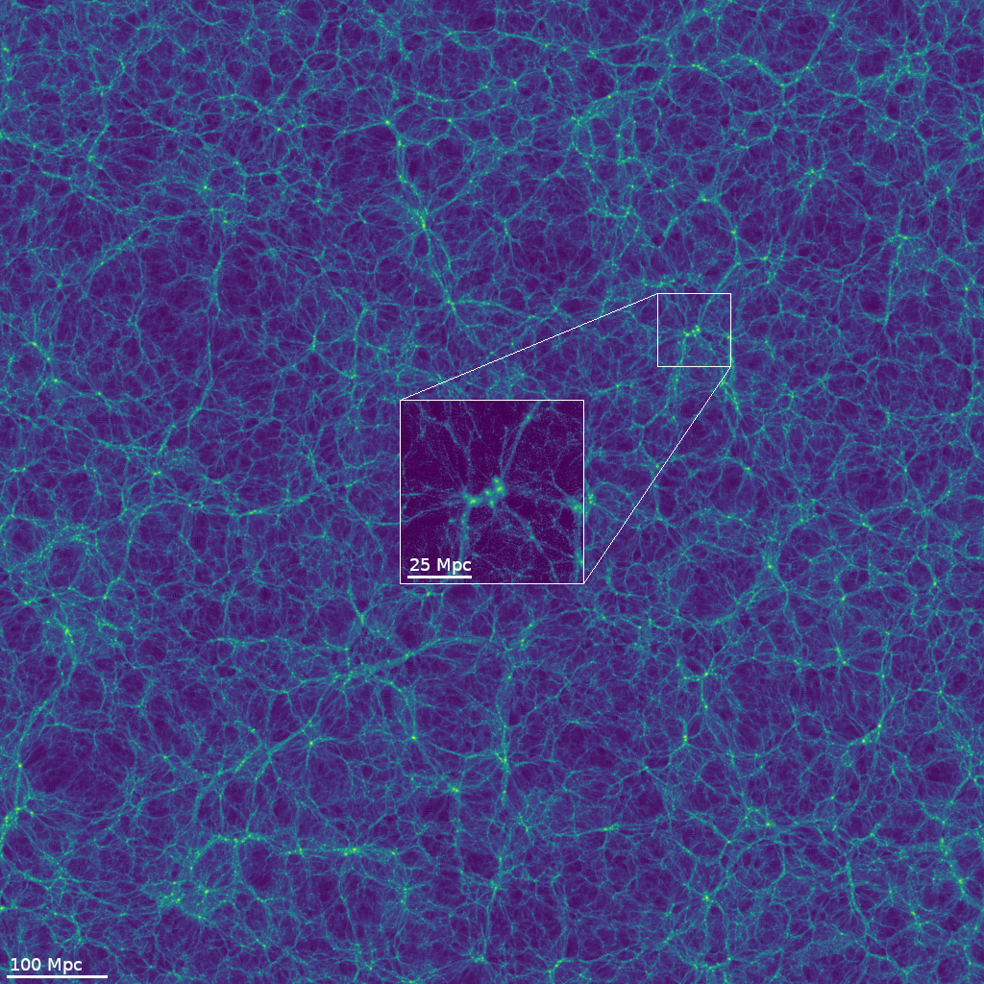
CDM

Slide 18
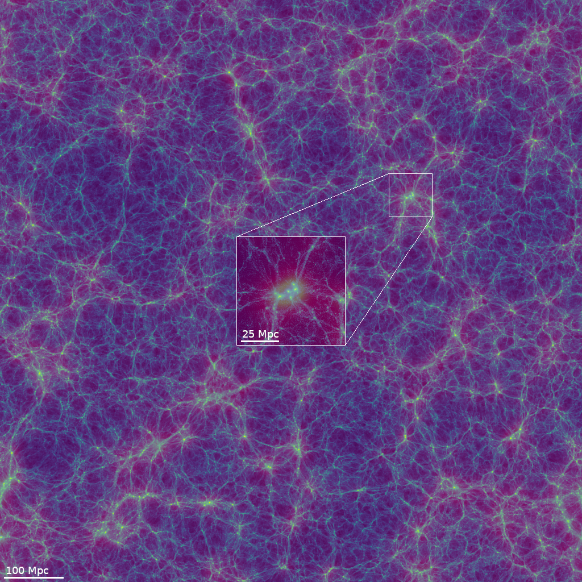
0.48eV

Slide 19
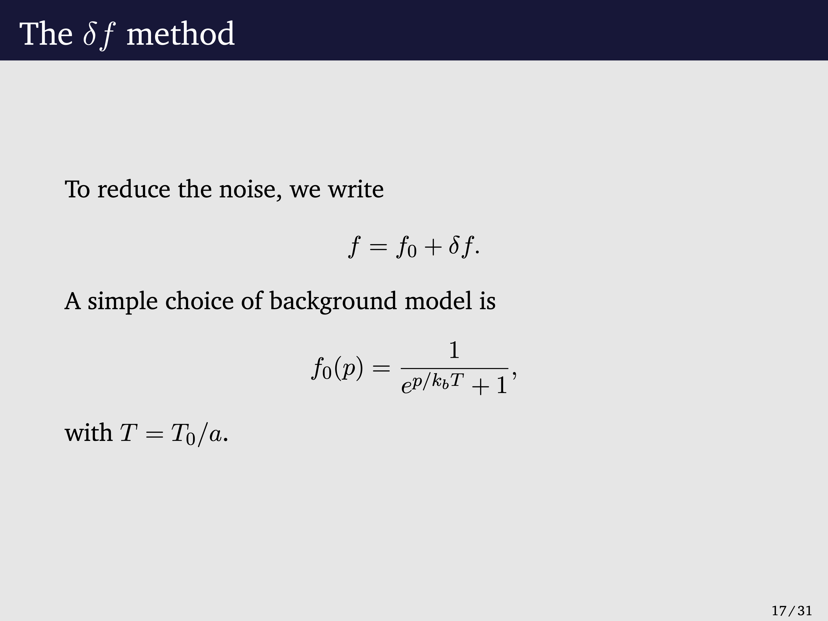
Elbers et al 2021 - slides Willem Elbers

Slide 20
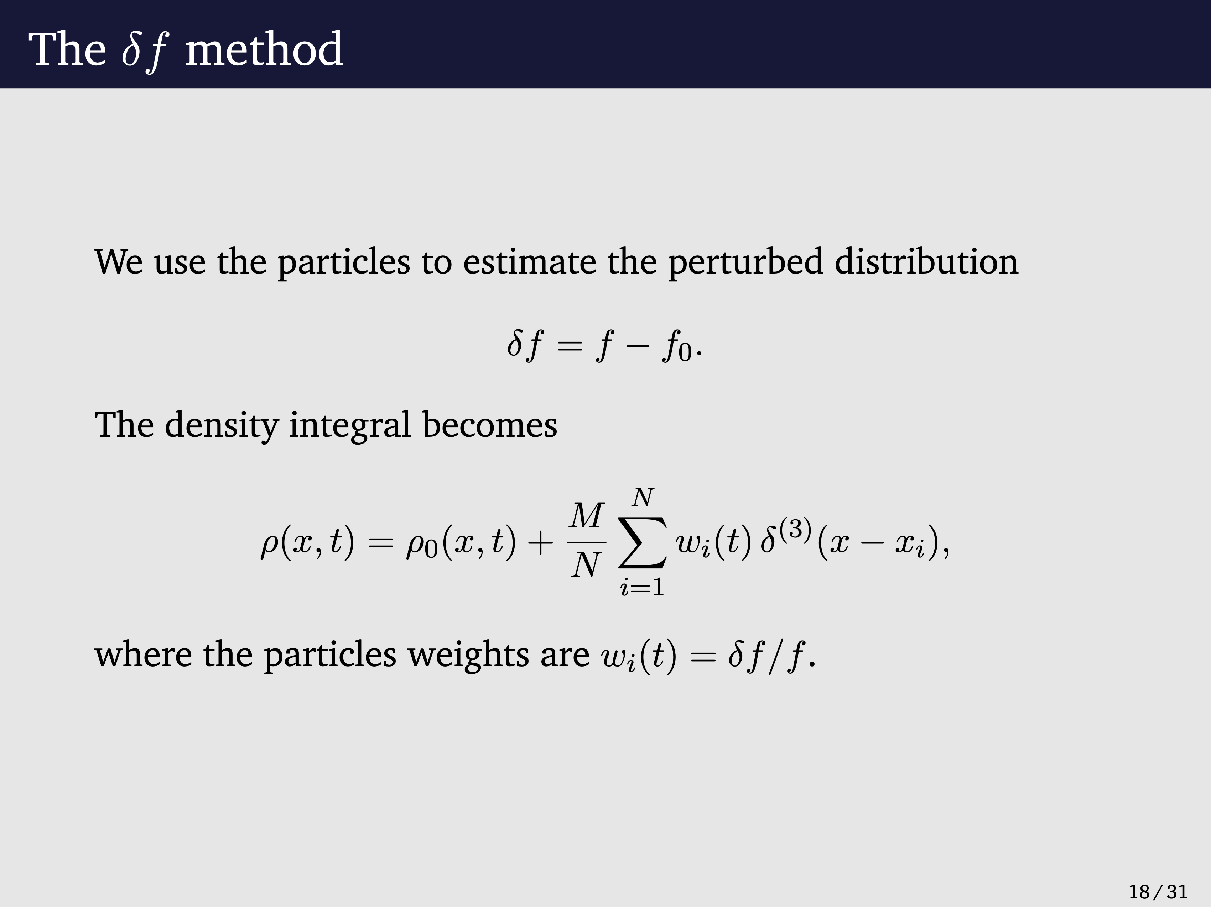

Slide 21
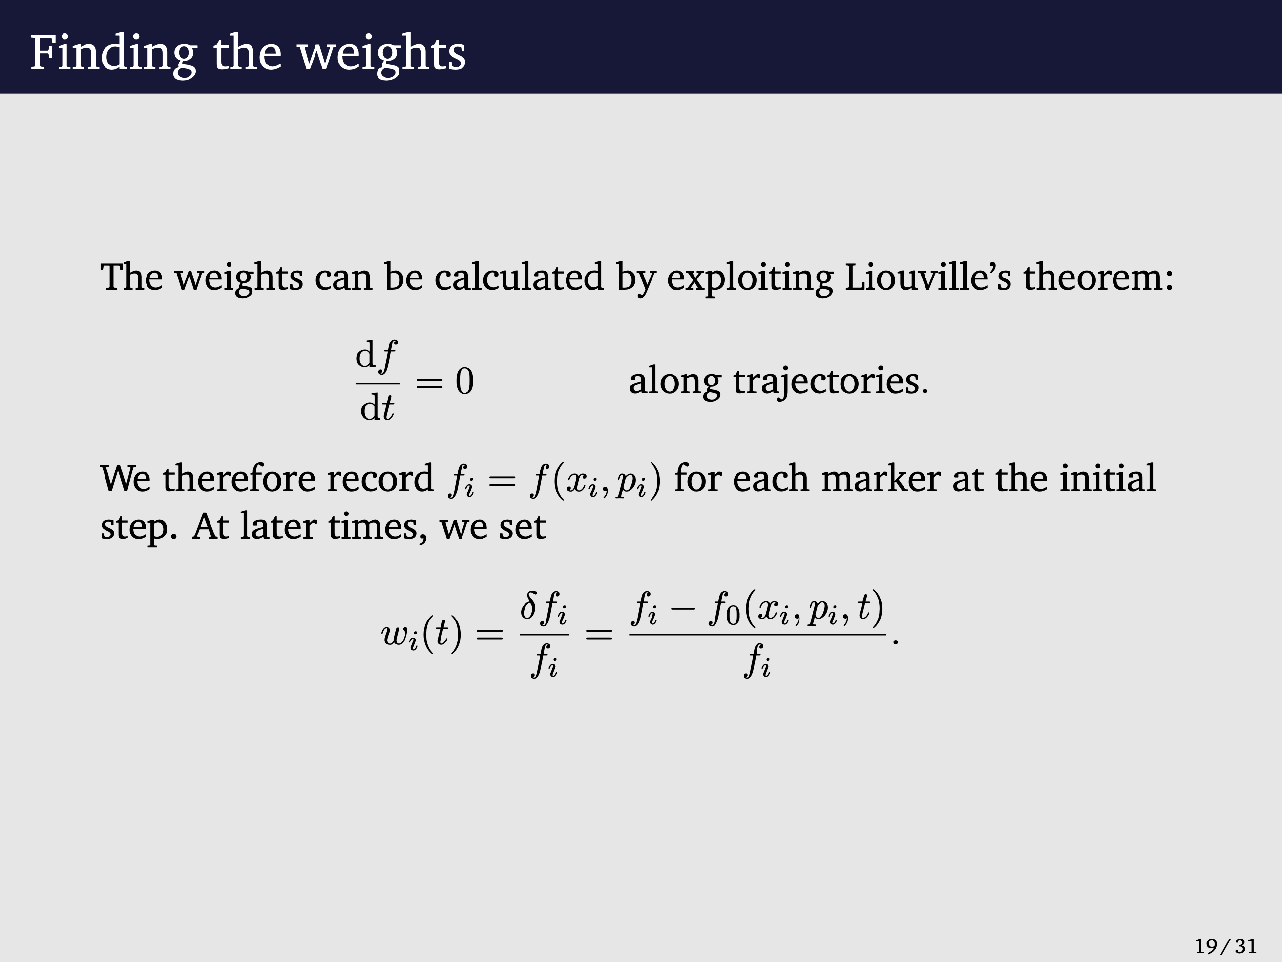

Slide 22
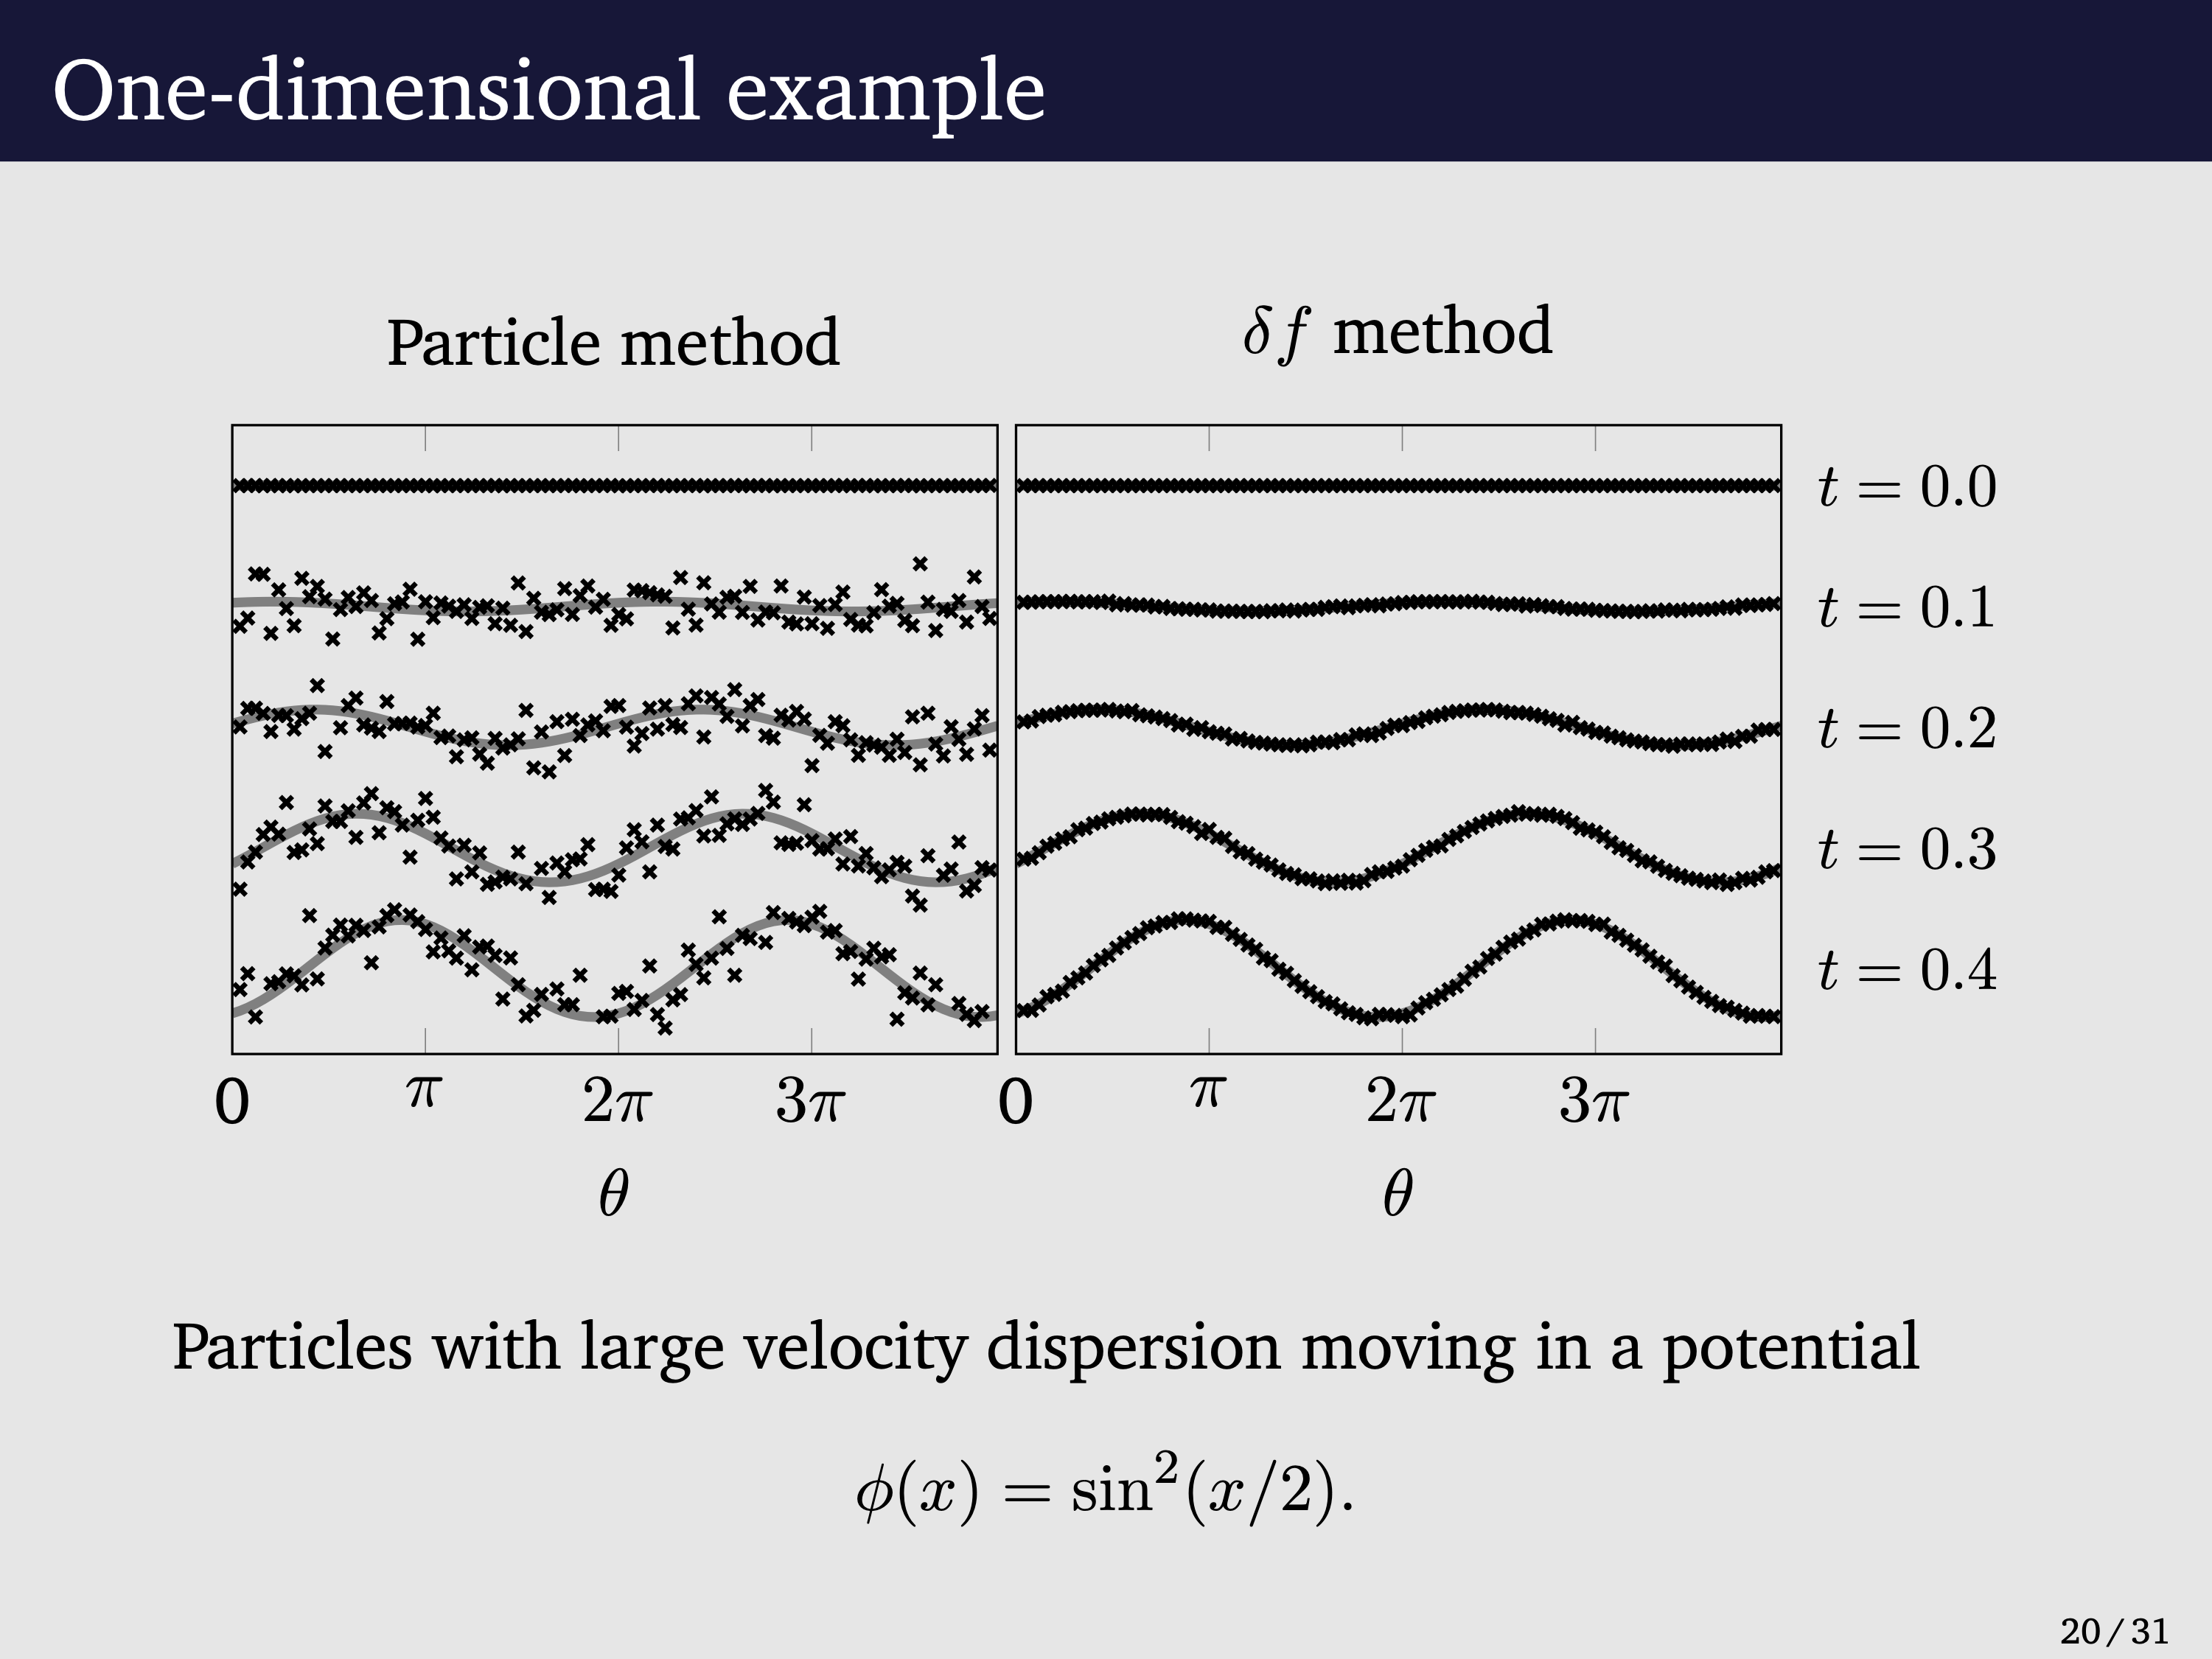

Slide 23
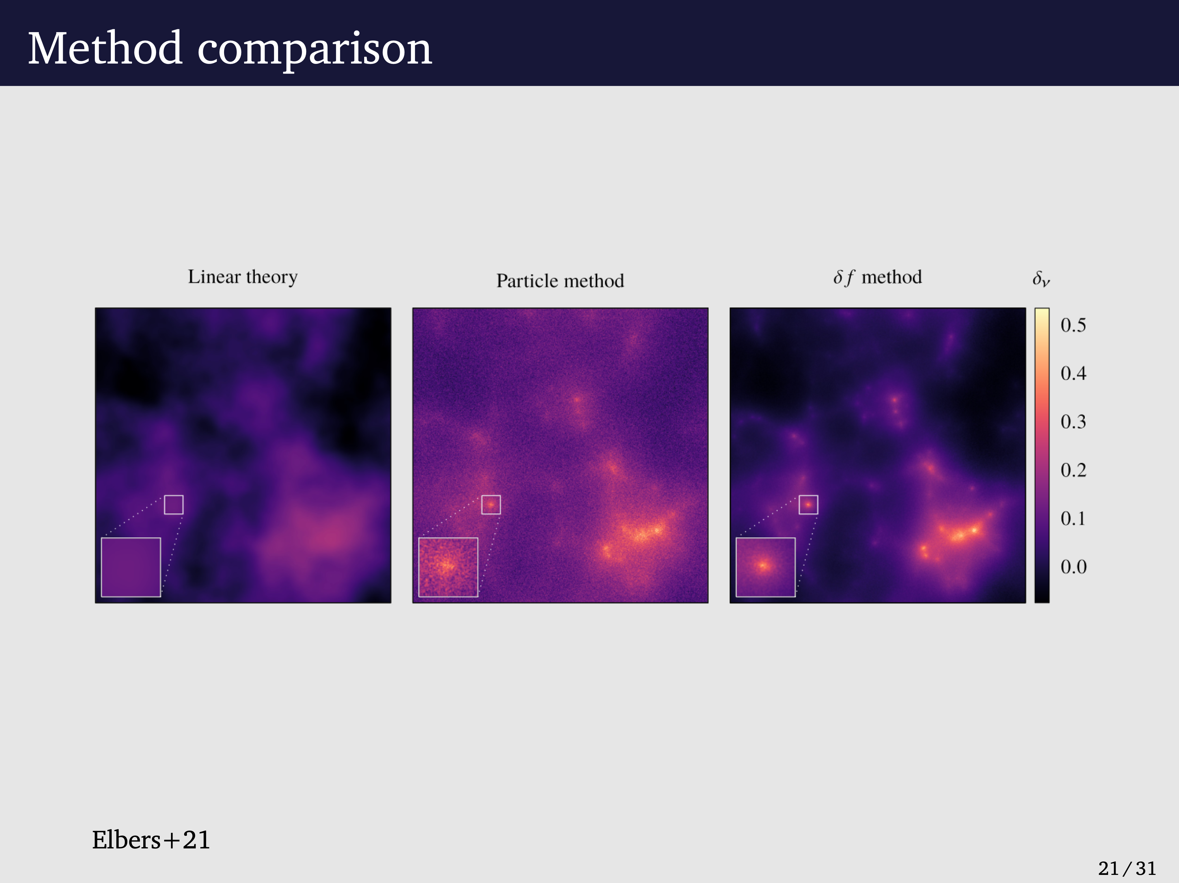

Slide 24
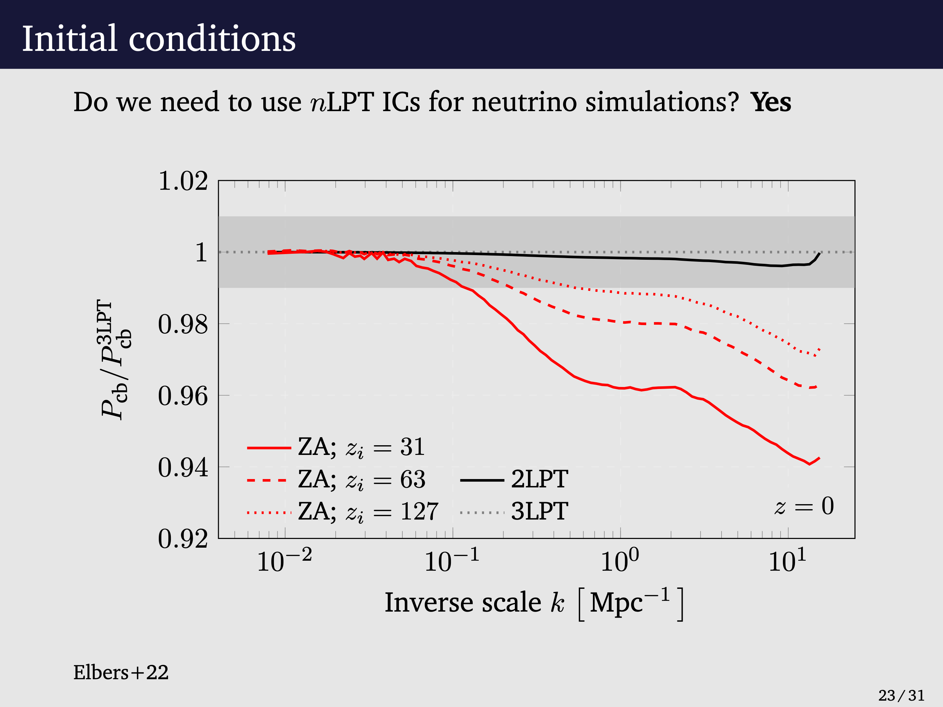
Matter Power Spectrum

Slide 25
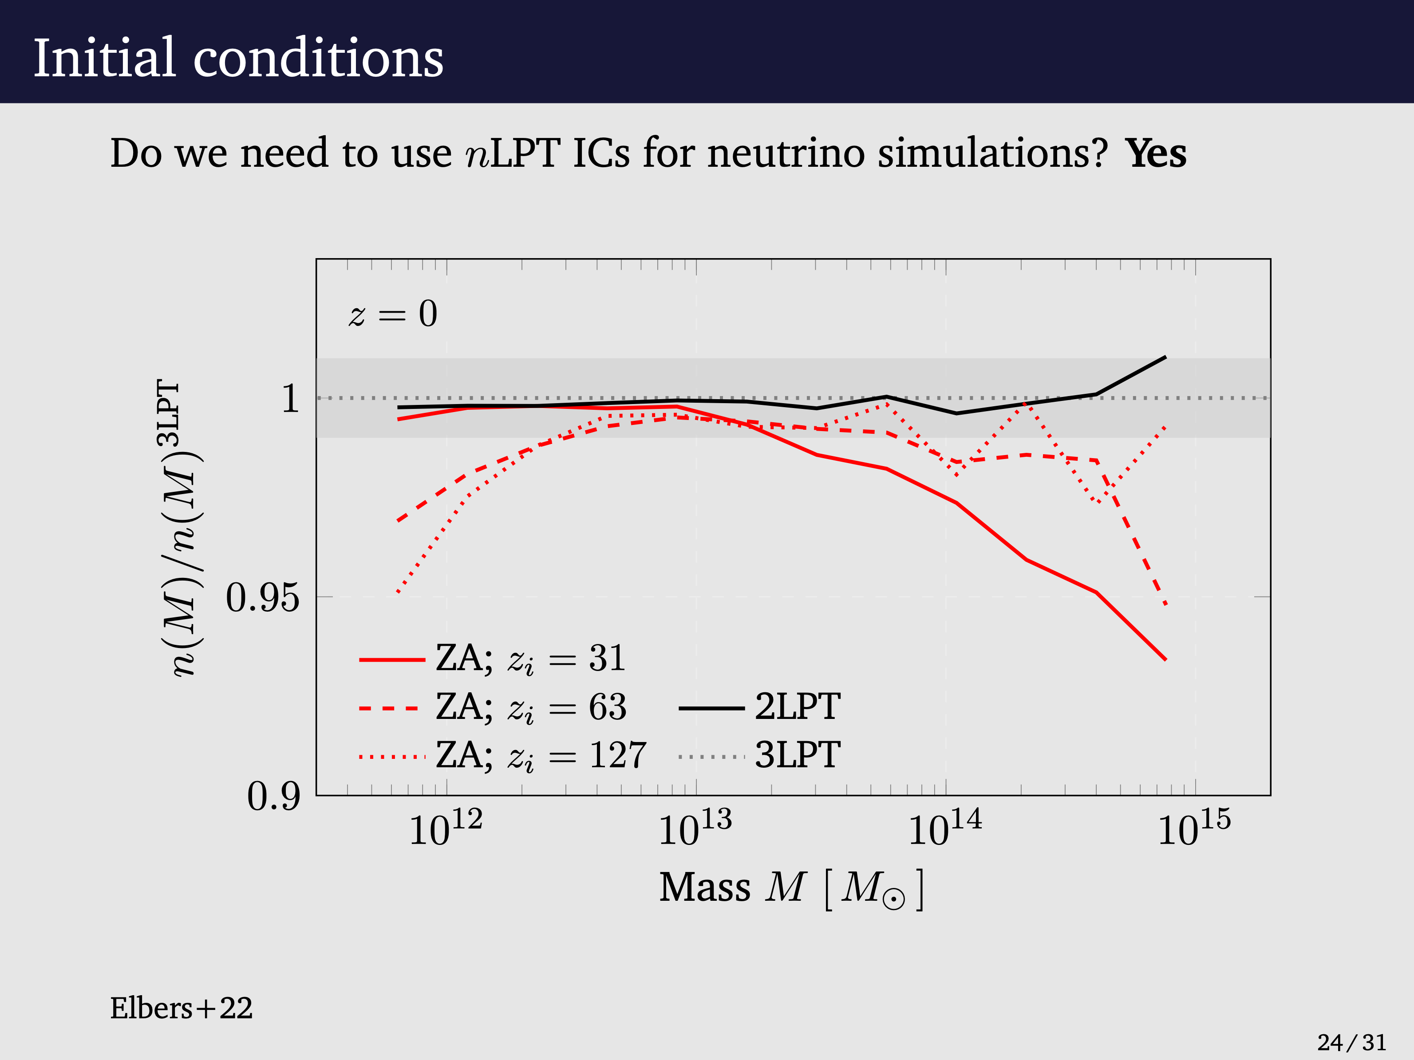
Halo mass function

Slide 26
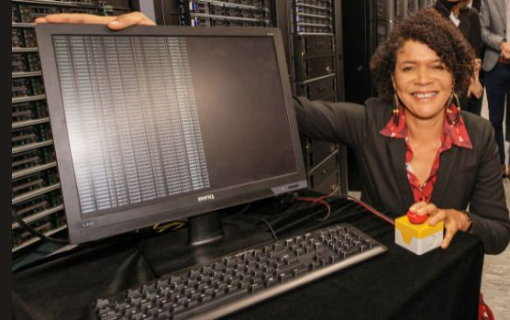
Flamingo simulations
Chi Onwurah, MP
All completed in 2023 apart from Flamingo 10K
The flagship Flamingo run L2800N5040. - 240 nodes taking 42 days walk-clock time
Flamingo L1000N3600 - 120 nodes taking 40 days
Flamingo 10K - dark matter only - L2800L10080 - 512 nodes 22 days 35M core-hours
25 published/arXiv papers so far
97 declared projects using Flamingo data - 31 UK with PIs at 9 UK institutions

Slide 27
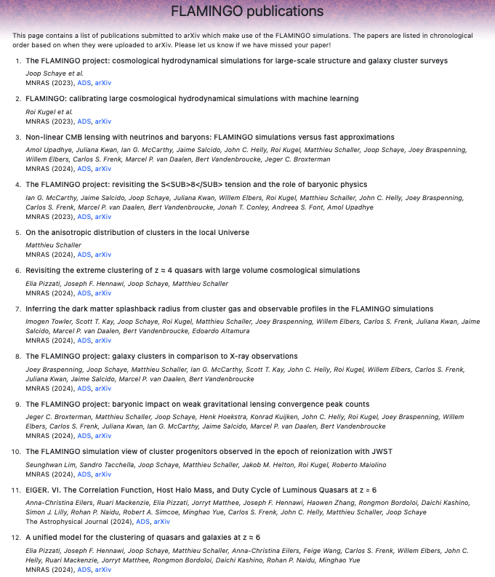
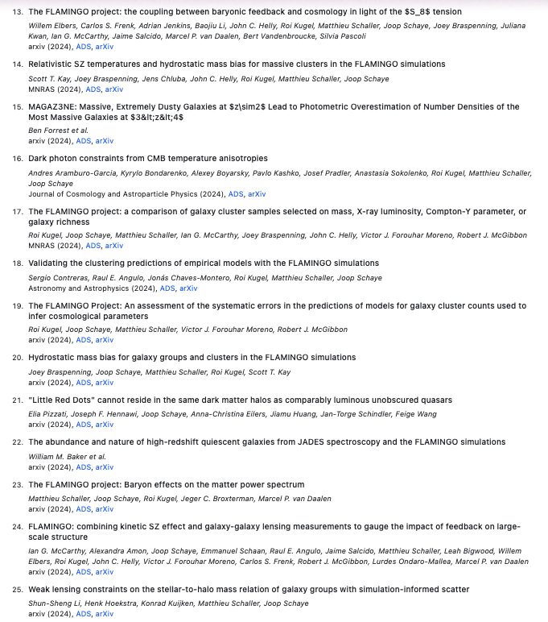

Slide 28
Overview
Memory Intensive calculations
The DiRAC-3 Memory Intensive System
The SWIFT hydrodynamic code
Two examples using SWIFT of MI simulations:
Flamingo project - Large-scale structure
Colibre project - Galaxy formation
Summary

Slide 29
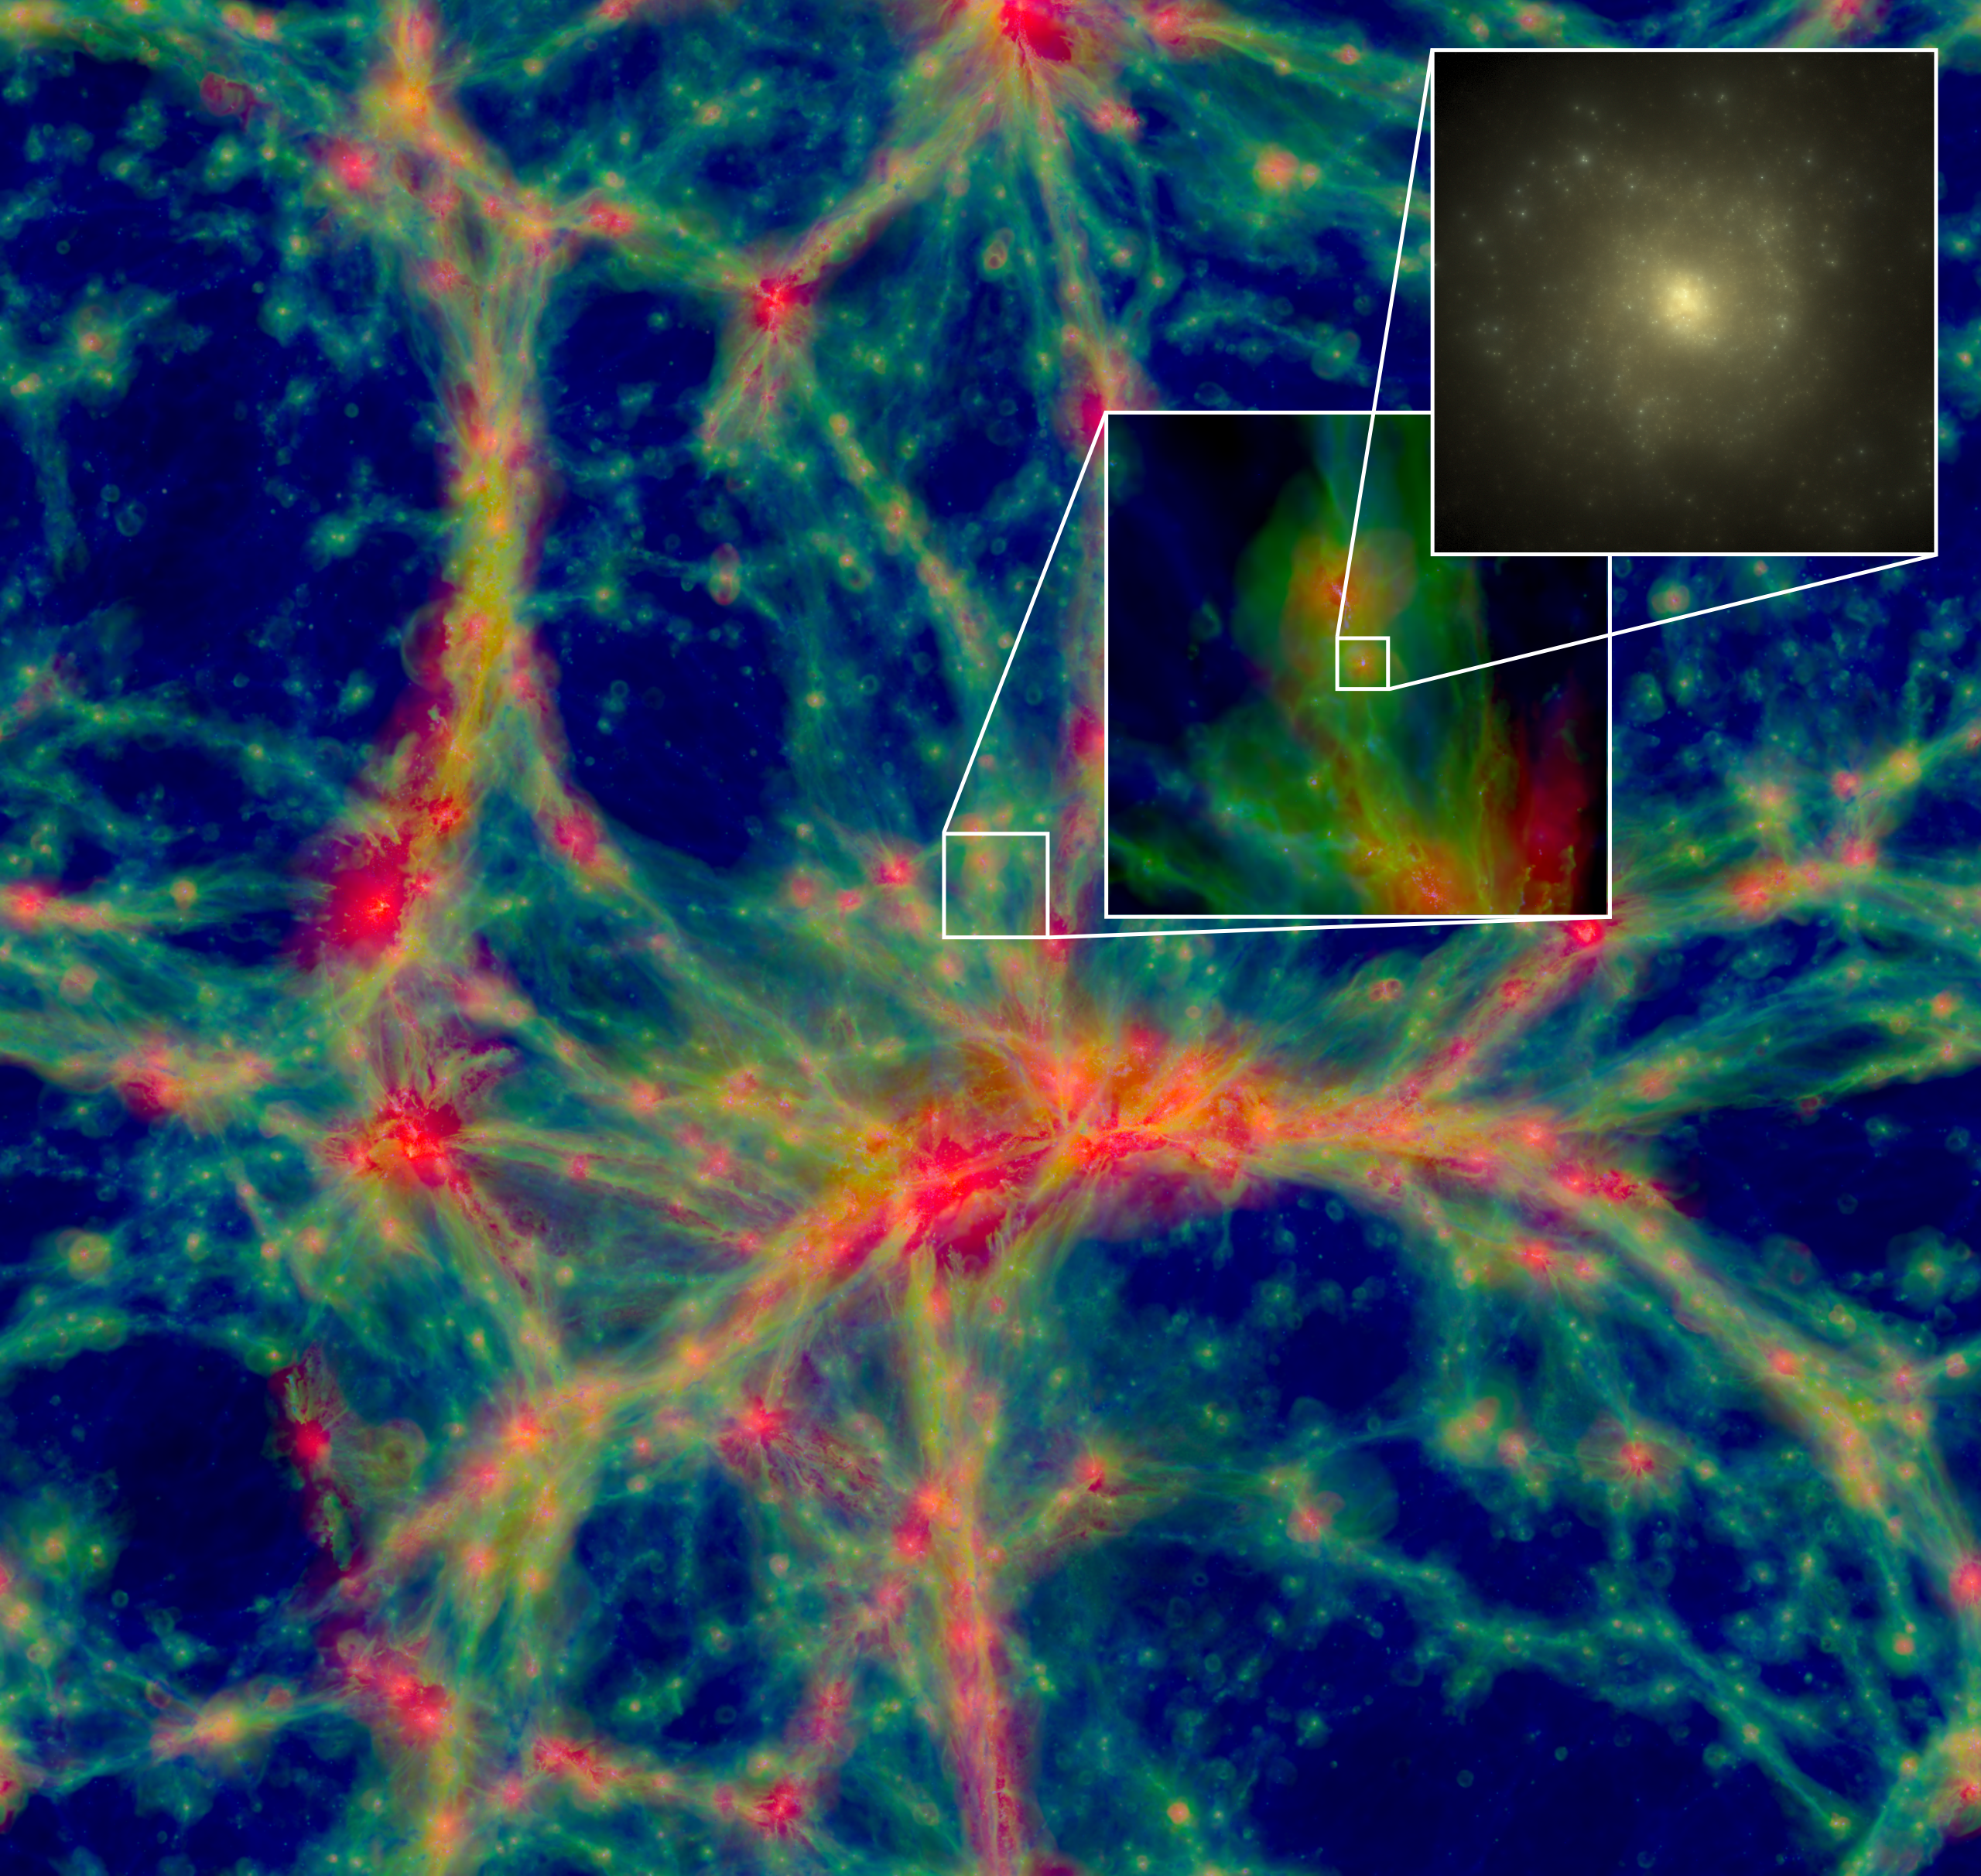
From Eagle -> Colibre
Eagle
Colibre
Image credit:
Stu McAlpine
Colibre has a cold ISM - Eagle prevented gas cooling below 8000K
Colibre has interstellar dust.through a subgrid model (Trayford et al in prep)
C0libre has non-equilibrium cooling of H, He (using Chimes)
C0libre has x4 more dark matter particles then Eagle
Colibre has a turbulent mixing model (Corea et al in prep)

Slide 30
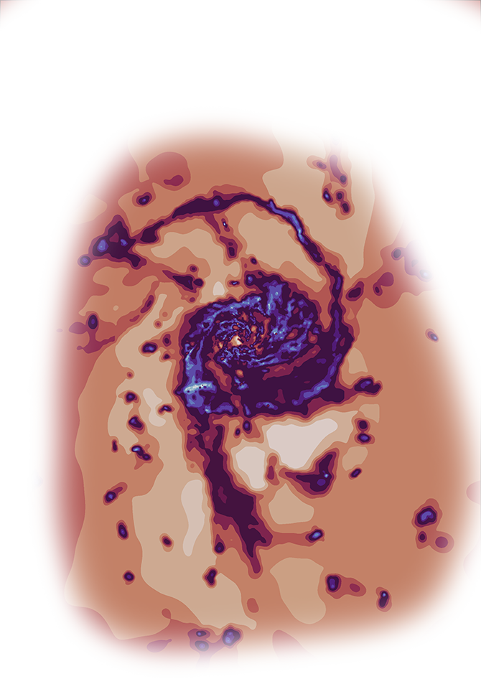
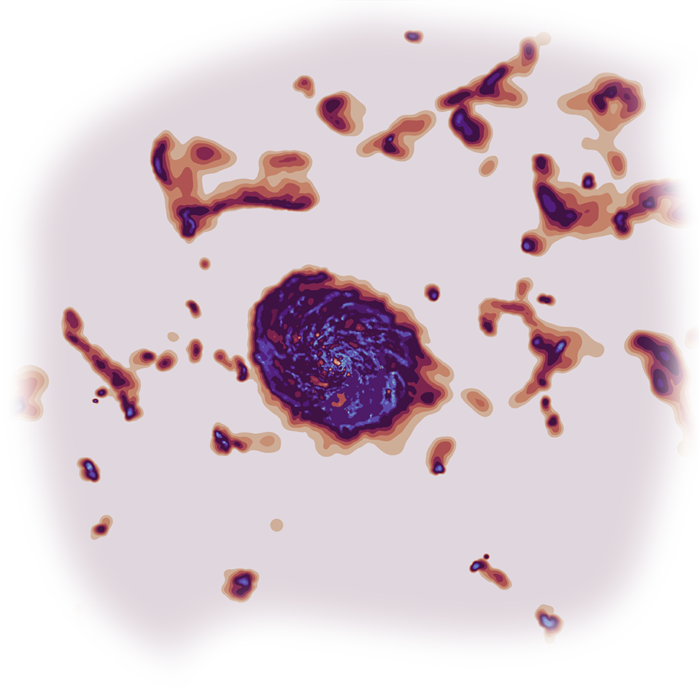
The COLIBRE project
cosmological simulations of galaxy formation including
cold interstellar gas
Evgenii Chaikin
Leiden Observatory
Supervisors: Joop Schaye, Matthieu Schaller
October 22, 2024, Ringberg workshop

Slide 31

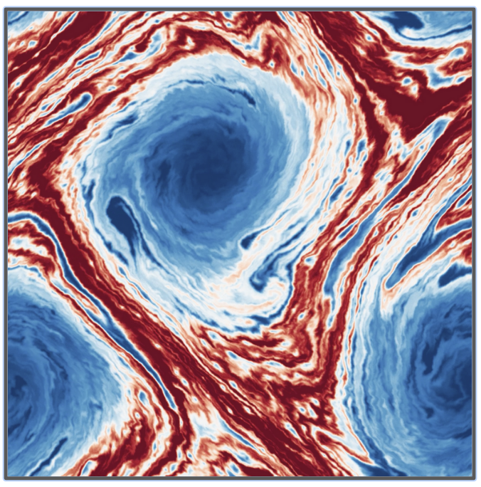
The COLIBRE galaxy formation model
Astrophysical code:
Swift
(Schaller et al. 2024)
COLIBRE development team:
Joop Schaye (PI)
Yannick Bahé
Alejandro Benítez-Llambay
Evgenii Chaikin
Camila Correa
Carlos Frenk
Victor Forouhar-Moreno
John Helly
Filip Husko
Rob McGibbon
Folkert Nobels
Sylvia Ploeckinger
Alex Richings
Matthieu Schaller
James Trayford
Hydrodynamical solver:
Sphenix
(Borrow et al. 2022)

Slide 32
Cooling, chemistry, and dust
Cooling:
Non-equilibrium chemistry solver CHIMES (Richings et al. 2014) for H and He
Metal cooling by (an updated version of) the Ploeckinger & Schaye (2020) equilibrium cooling tables
Chemistry:
H, He, C, N, O, Ne, Mg, Si, Fe, Sr, Ba, and Eu are individually tracked
A turbulent mixing model for diffusion (Correa et al., in prep.)
Dust:
A 3-species, 2-grain sizes dust evolution model coupled to the chemistry (Trayford et al., in prep.)

Slide 33
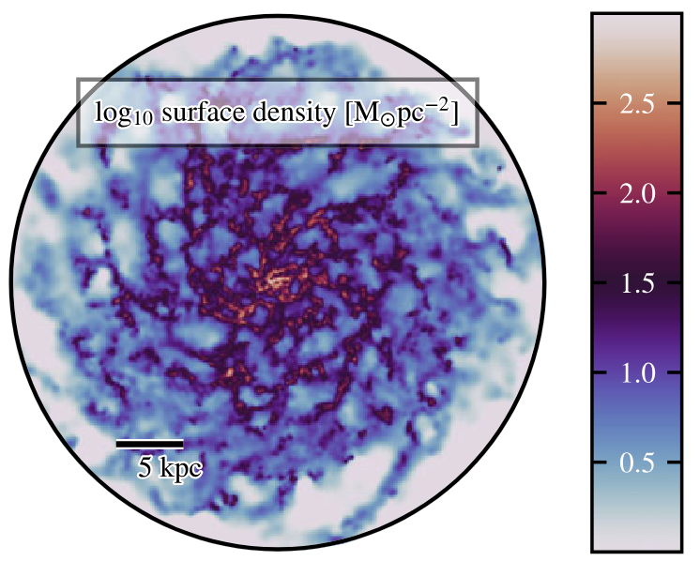
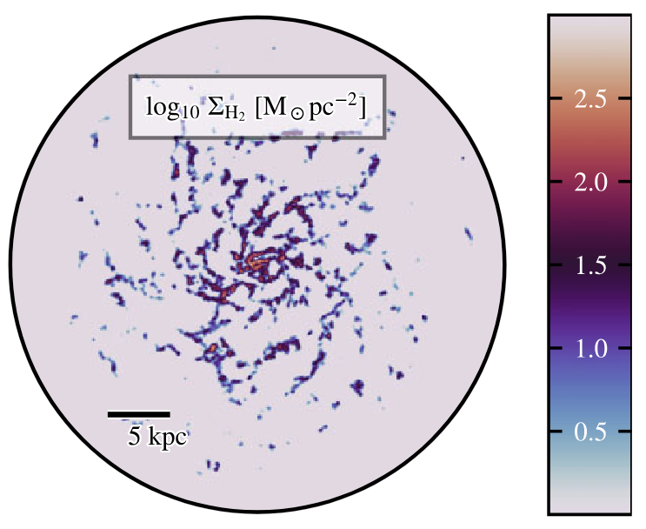
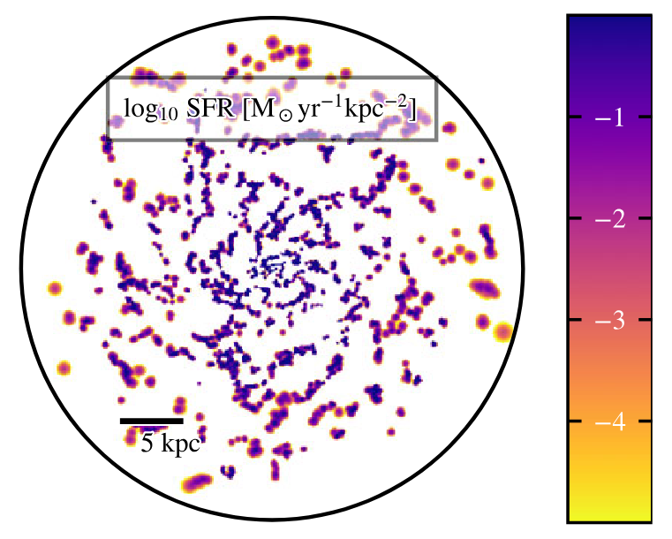
Star formation and stellar feedback
Star formation: grav. instability criterion with the Schmidt star-formation law (Nobels et al., 2024)
Chemical enrichment: AGB stars, type-Ia SNe, type-II SNe, neutron star mergers, common envelope jets SNe, and collapsars
Energy & momentum feedback:
HII regions, stellar winds, and radiation pressure (Benitez-Llambay, Ploeckinger et al., in prep)
Stochastic isotropic type-Ia and CC SN feedback (based on Chaikin et al. 2022, 2023)
Tests of COLIBRE star formation prescription (Nobels et al., 2024)

Slide 34
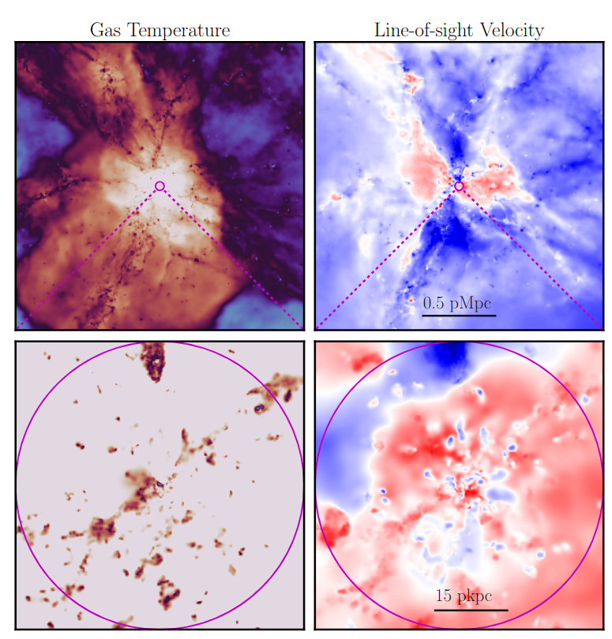
Black holes and AGN feedback
Mass accretion: Bondi-Hoyle (+ Krumholz et al. 2006 corrections for vorticity & turbulence)
Accreted mass continuously nibbled from the gas (Bahé et al. 2022)
Dynamical friction: BHe `re-position’ towards lower gravitational potential (Bahé et al. 2022)
Two flavours of AGN energy feedback
Stochastic thermal feedback (akin to Booth & Schaye 2009)
Hybrid (thermal + jets) feedback + BH spin evolution (Husko et al. 2022, 2023)

Slide 35
Target volumes and resolutions
Resolution | Box size [cMpc] | Gas mass [M☉] | DM mass [M☉] | Total N of particles
m7 | 400 | 1.5 x 10⁷ | 2.0 x 10⁷ | 5 x 3008³
m6 | 200 | 1.8 x 10⁶ | 2.4 x 10⁶ | 5 x 3008³
m5 | 100 | 2.3 x 10⁵ | 3.0 x 10⁵ | 5 x 3008³
+ planned in the longer term
m4 | 30 | 2.9 x 10⁴ | 3.8 x 10⁴ | 5 x 1804³

Slide 36
Calibration

Slide 37
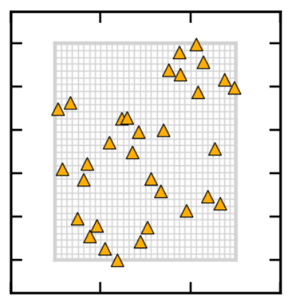
Calibration at m7 resolution using emulators
Gaussian-process emulators (Kugel & Borrow, 2022; Kugel et al., 2023) at m7 resolution for calibrating
galaxy stellar mass function at z=0
size-stellar mass relation at z=0
Likelihood-based optimization of
one AGN feedback parameter (BH seed mass)
three SN feedback parameters
Latin hypercube sampling of the parameter space with 40 (L = 50 cMpc)³ simulations
Parameter 2
Parameter 1
From Chaikin et al., in prep: orange triangles are individual simulations

Slide 38
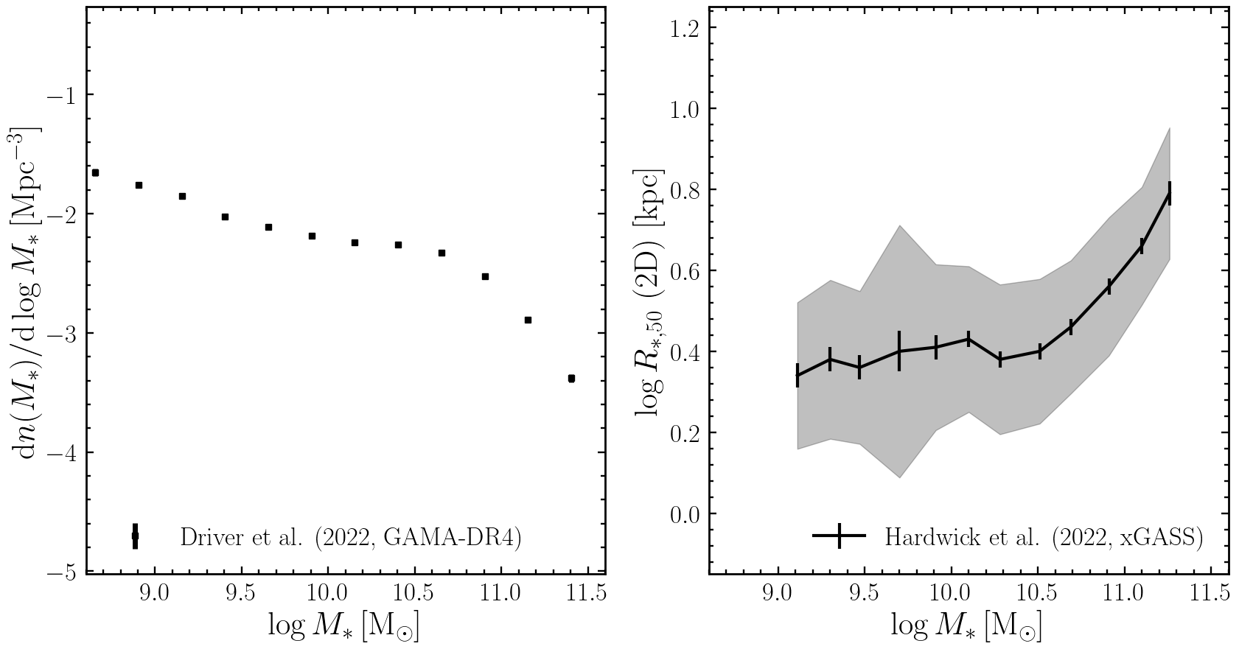
Target observational data
Two z~0 observational datasets:
Galaxy stellar mass function from Driver et al. (2022)
Galaxy size-stellar mass relation from Hardwick et al. (2022)

Slide 39
Results

Slide 40
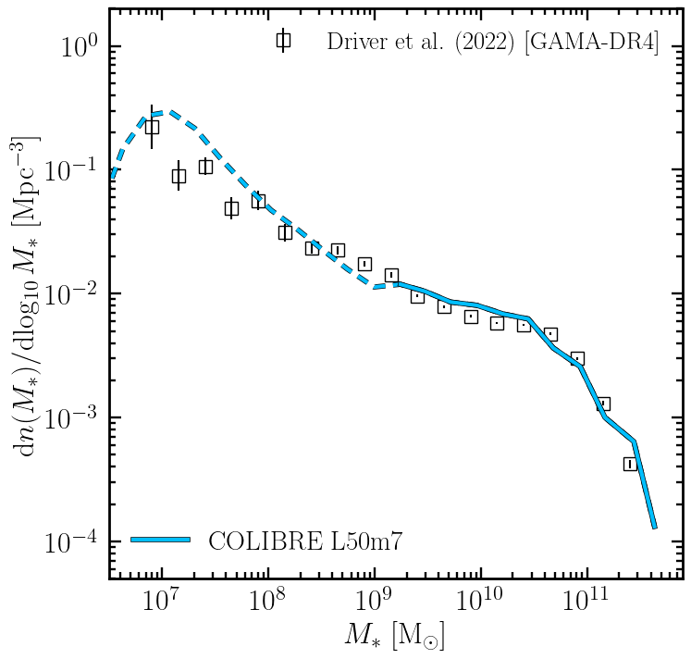
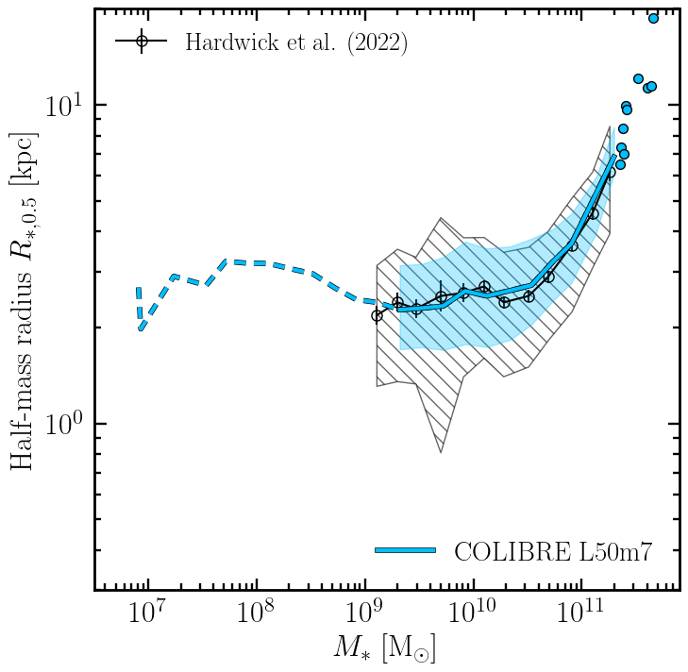
Calibrated properties (GSMF and sizes) at m7 res

Slide 41
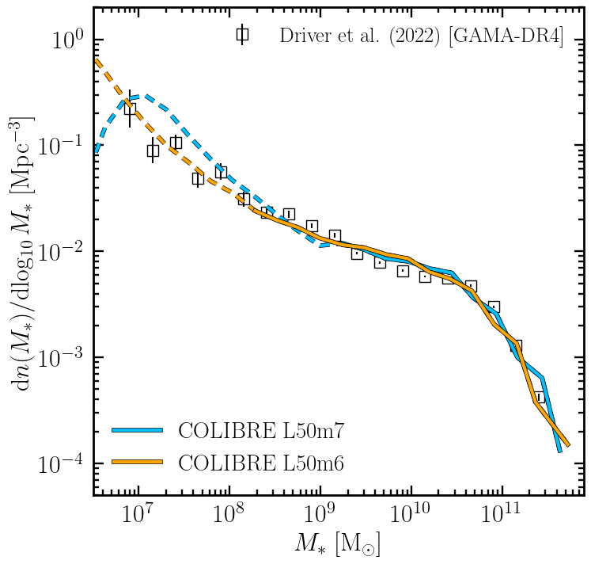
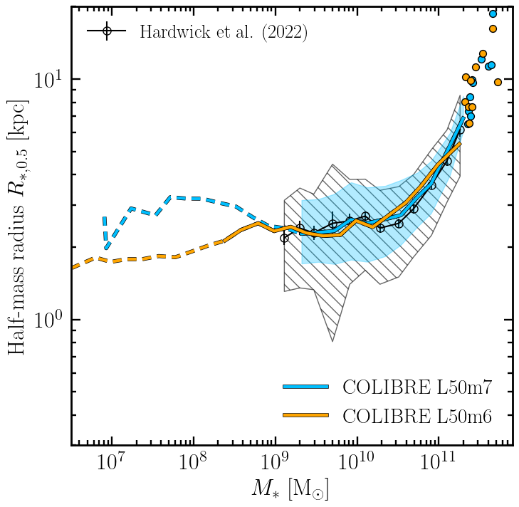
Calibrated properties (GSMF and sizes)

Slide 42
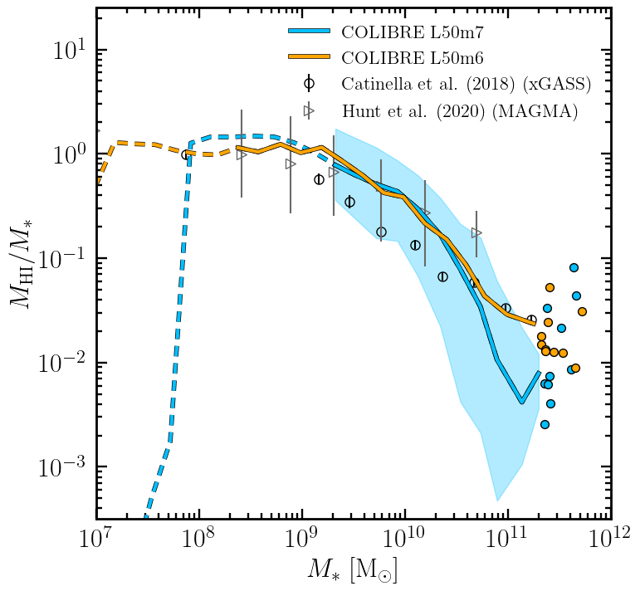
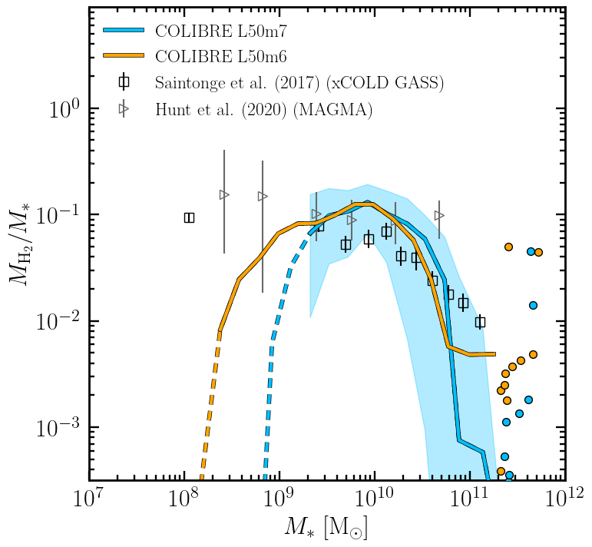
Cold gas properties

Slide 43
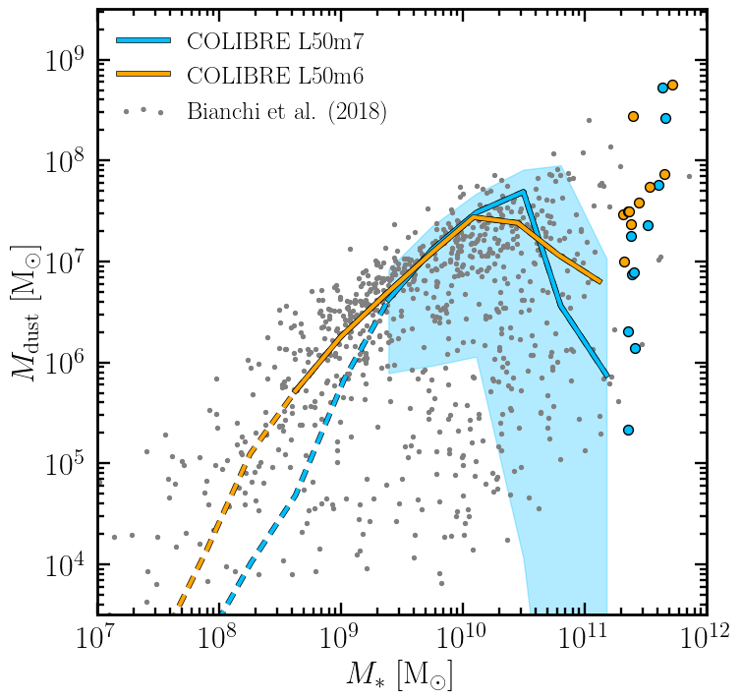
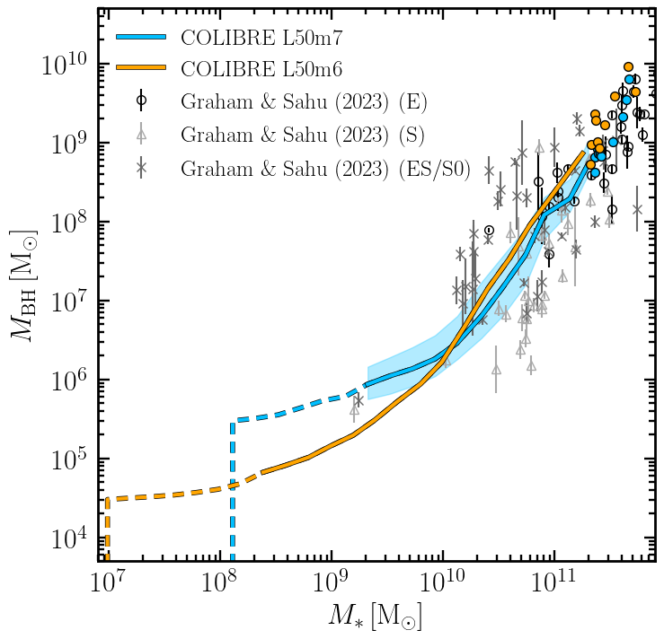
Dust and black hole masses

Slide 44
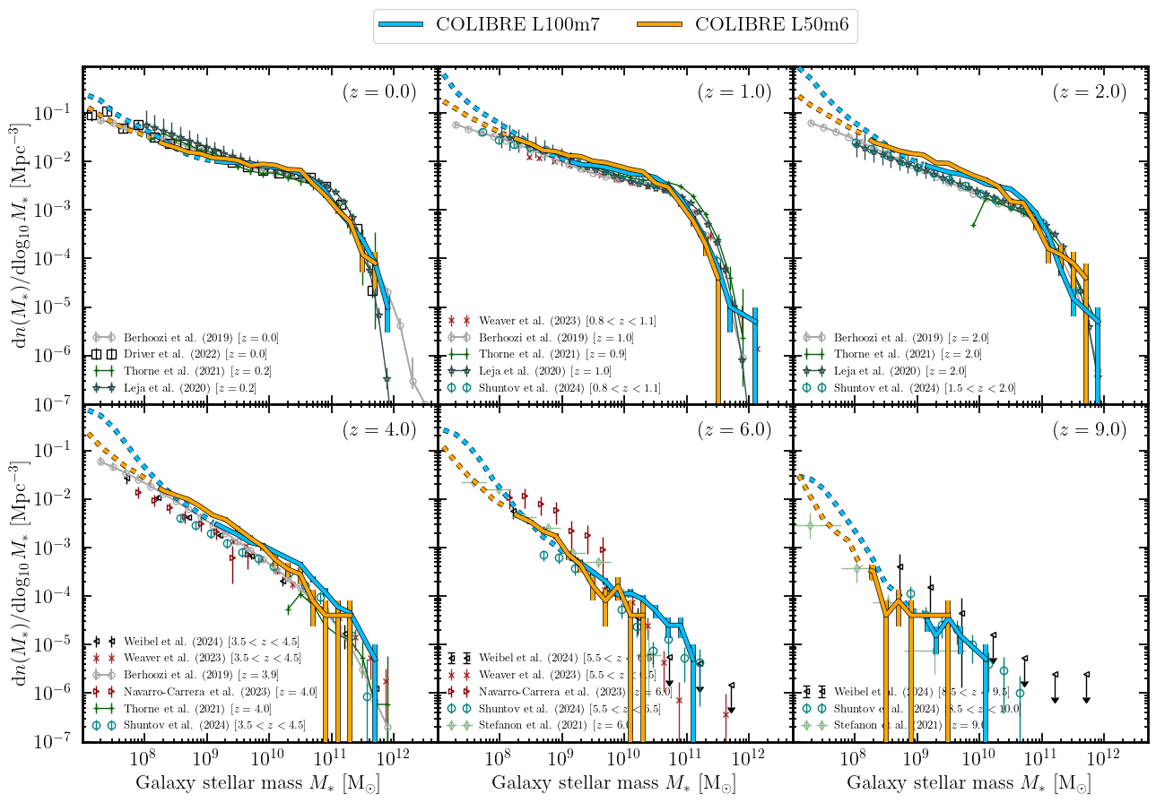
Evolution of the GSMF
Chaikin et al., in prep

Slide 45
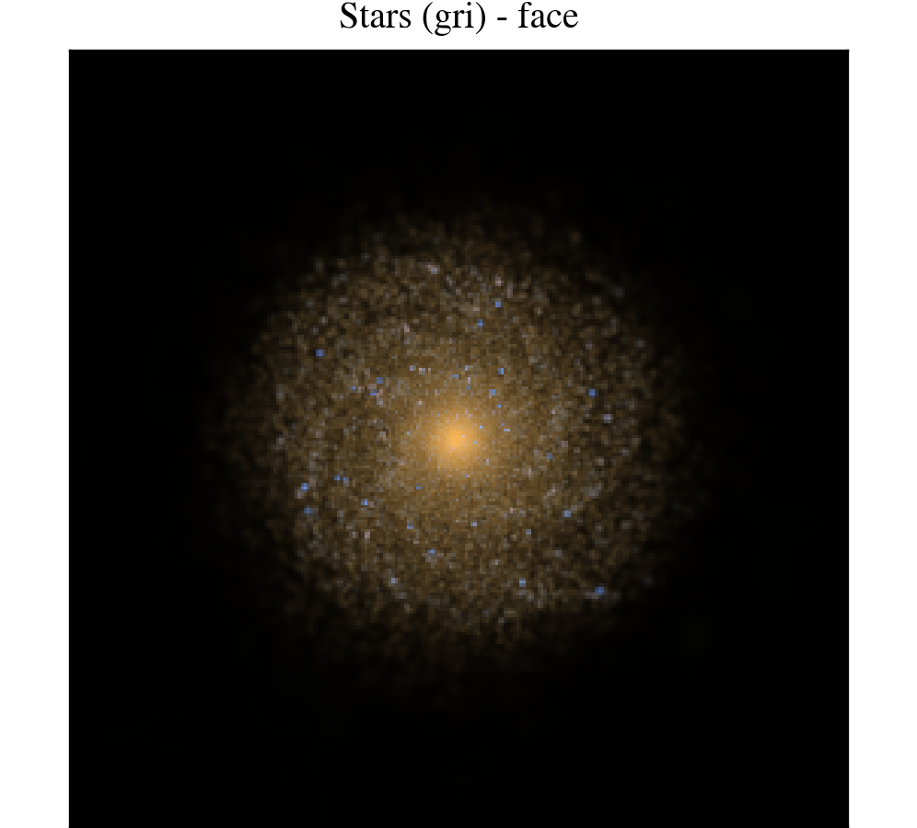
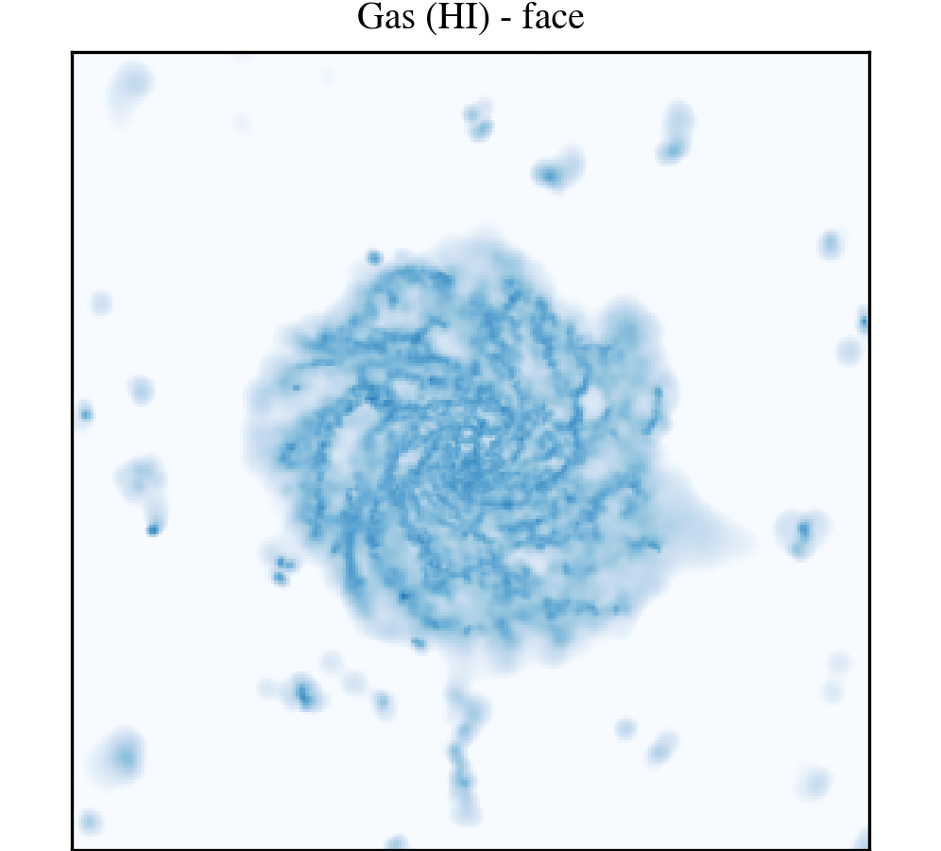
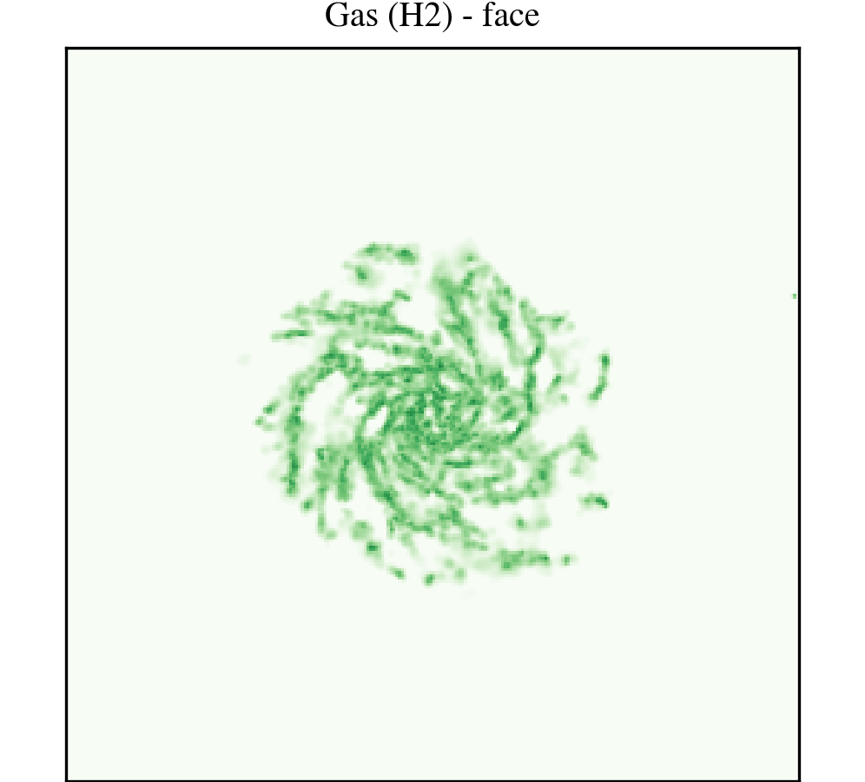



Morphology of COLIBRE galaxies at m5 res

Slide 46


Spatially-resolved properties at m5 res
COLIBRE m5

Slide 47
Summary
m6 and m7 COLIBRE models are ready. Large volumes are already running
COLIBRE m5 is about to be ready
2. COLIBRE m7 calibrated by emulators. Parameters at m6 and m5 inferred from m7
3. COLIBRE (SN and AGN feedback) has been calibrated to match the observed galaxy stellar mass function and size-mass relation at z=0
4. Thanks to point 3, COLIBRE also reproduces various other low- and high-z observations

Slide 48
Colibre simulations
Many smaller volumes completed together with dark matter only counterparts
Currently running Flagship - L0400N3008 - 16o nodes - 120 TB of RAM - expected wall-clock time of 45 days
Many projects have begun using the smaller volume Colibre boxes
As with Eagle the data will be made public as far as possible. While possible to replicate the Eagle database the data is much richer and the raw data will be 1 PB

Slide 49
Summary
The DiRAC-3 Memory Intensive system is making it possible to run
a new generation of very large cosmological hydrodynamical simulations in both
large-scale structure (Flamingo) and galaxy formation (Colibre)
The projects require teams of tens of people and many years to develop and test subgrid models, run the simulations and produce the first scientific returns. The data produced will likely be useful for a least a decade based on past experience.
The DiRAC-3 facility has enabled the UK to be competitive in these fields.

Slide 50
THE END

Slide 52
Stats
Snap8. - 118 seconds 36.5TB 160 nodes - 316 Gbytes/s. - Colibremvlvv
Cosma8/data. - 1100 seconds - 4TB of compressed data
Flamingo hydro 240 nodes (ROME) - 960 MPI ranks - 14% load imbalance
Flamingo 10k. 512 nodes - 1024 mph ranks - 32% imbalance - Rome/Milan
96 projects declared using Flamingo - 25 published. - 31 with UK leads 9 uk institutions

